Slide 1
Module 6 Authentication and Remote Access and Intrusion Detection Systems and Network Security – Part 1

Slide 2
Module 6 Learning Objectives
On successful completion of this module, students should be able to:
discuss the methods and protocols for remote access to networks
identify and describe authentication, authorisation and accounting (AAA) protocols
explain authentication methods and the security implications in their use
implement virtual private networks (VPN) and their security aspects
describe Internet protocol security (IPsec) and its use in securing communications
apply the appropriate network tools to facilitate network security
determine the appropriate use of network security tools to facilitate network security
apply host based security applications.

Slide 3
Module 6 Learning Resources
Conklin et al. 2016, Principles of Computer Security: CompTIA Security+, 4 th edn.
The readings from the text for this module are Chapter 11, pp. 288–335 and Chapter 13, pp. 377-407.

Slide 4
Key Terms
AAA
Access control
Access control list (ACL)
Accounting
Administrator
Attribute-based access control (ABAC)
Authentication
Authentication Header (AH)
Authentication server (AS)
Authorization
Content protection
Context protection
Discretionary access control (DAC)
Notes:
AAA – Acronym for authentication, authorization, and accounting (AAA). They are three common functions performed upon system login. Authentication and authorization almost always occur, with accounting being somewhat less common.
Access control – Mechanism or method used to determine what access permissions subjects (such as users) have for specific objects (such as files).
Access control list (ACL) – A list associated with an object (such as a file) that identifies what level of access each subject (such as a user) has—what they can do to the object (such as read, write, or execute).
Accounting – The collection of billing and other detail records.
Administrator – A superuser account under the Windows operating system.
Attribute-based access control (ABAC) – An access control model built around a set of rules built upon specific attributes.
Authentication – The process by which a subject’s (such as a user’s) identity is verified.
Authentication Header (AH) – A portion of the IPsec security protocol that provides authentication services and replay-detection ability. AH can be used either by itself or with Encapsulating Security Payload (ESP). Refer to RFC 2402.
Authentication server (AS) – A server used to perform authentication tasks.
Authorization – The function of determining what is permitted for an authorized user.
Content protection – The protection of the header and data portion of a user datagram.
Context protection – The protection of the header of a user datagram.
Discretionary access control (DAC) – An access control mechanism in which the owner of an object (such as a file) can decide which other subjects (such as other users) may have access to the object, and what access (read, write, execute) these objects can have.

Slide 5
Key Terms (continued)
Domain controller
Domain password policy
Encapsulating Security Payload (ESP)
eXtensible Access Control Markup Language (XACML)
Group
Group policy object (GPO)
Identification
Internet Key Exchange (IKE)
Internet Protocol Security (IPsec)
Notes:
Domain controller – A computer that responds to security authentication requests, such as logging into a computer, for a Windows domain.
Domain password policy – A password policy for a specific domain.
Encapsulating Security Payload (ESP) – A portion of the IPsec implementation that provides for data confidentiality with optional authentication and replay detection services. ESP completely encapsulates user data in the datagram and can be used either by itself or in conjunction with Authentication Headers for varying degrees of IPsec services.
eXtensible Access Control Markup Language (XACML) – An open standard XML-based language used to describe access control.
Group – A collection of users with some common criteria, such as a need for access to a particular dataset or group of applications.
Group policy object (GPO) – Stores the group policy settings in a Microsoft Active Directory environment.
Identification – The process of determining identity as part of identity management and access control. Usually performed only once, when the user ID is assigned.
Internet Key Exchange (IKE) – The protocol formerly known as ISAKMP/Oakley, defined in RFC 2409. A hybrid protocol that uses part of the Oakley and part of the Secure Key Exchange Mechanism for Internet (SKEMI) protocol suites inside the Internet Security Association and Key Management Protocol (ISAKMP) framework. IKE is used to establish a shared security policy and authenticated keys for services that require keys (such as IPsec).
Internet Protocol Security (IPsec) – A protocol used to secure IP packets during transmission across a network. IPsec offers authentication, integrity, and confidentiality services and uses Authentication Headers (AH) and Encapsulating Security Payload (ESP) to accomplish this functionality.

Slide 6
Key Terms (continued)
Internet Security Association and Key Management Protocol (ISAKMP)
Kerberos
Key distribution center (KDC)
Layer 2 Tunneling Protocol (L2TP)
Mandatory access control (MAC)
Oakley
Password policy
Permissions
Point-to-Point Tunneling Protocol (PPTP)
Privilege management
Notes:
Internet Security Association and Key Management Protocol (ISAKMP) – A protocol framework that defines the mechanics of implementing a key exchange protocol and negotiation of a security policy.
Kerberos – A network authentication protocol designed by MIT for use in client/server environments.
Key distribution center (KDC) – A portion of the Kerberos authentication system.
Layer 2 Tunneling Protocol (L2TP) – A Cisco switching protocol that operates at the data link layer.
Mandatory access control (MAC) – An access control mechanism in which the security mechanism controls access to all objects (files), and individual subjects (processes or users) cannot change that access.
Oakley – A key exchange protocol that defines how to acquire authenticated keying material based on the Diffie-Hellman key exchange algorithm.
Password policy – A policy set up to help users select a good, difficult-to-guess password.
Permissions – Authorized actions a subject can perform on an object. See also access controls.
Point-to-Point Tunneling Protocol (PPTP) – The use of generic routing encapsulation over PPP to create a methodology used for virtual private networking.
Privilege management – The process of restricting a user’s ability to interact with the computer system.

Slide 7
Key Terms (continued)
Privileges
Remote access server (RAS)
Rights
Role
Role-based access control (RBAC)
Root
Rule-based access control
Secure Key Exchange Mechanism for Internet (SKEMI)
Security association (SA)
Single sign-on (SSO)
Superuser
Notes:
Privileges – Term meaning that you have the ability to “do something” on a computer system such as create a directory, delete a file, or run a program.
Remote access server (RAS) – A combination of hardware and software used to enable remote access to a network.
Rights – These define the actions a user can perform on the system itself, such as change the time, adjust auditing levels, and so on. Rights are typically applied to operating system–level tasks.
Role – Term used to describe a person’s job or function within the organization.
Role-based access control (RBAC) – An access control mechanism in which, instead of the users being assigned specific access permissions for the objects associated with the computer system or network, a set of roles that the user may perform is assigned to each user.
Root – An account under Unix that is reserved for special functions and typically have much more access and control over the computer system than the average user account.
Rule-based access control – An access control mechanism based on rules.
Secure Key Exchange Mechanism for Internet (SKEMI) – A protocol and standard for the key exchange across the Internet.
Security association (SA) – An instance of security policy and keying material applied to a specific data flow. Both IKE and IPsec use SAs, although these SAs are independent of one another. IPsec SAs are unidirectional and are unique in each security protocol, whereas IKE SAs are bidirectional. A set of SAs is needed for a protected data pipe, one SA per direction per protocol. SAs are uniquely identified by destination (IPsec endpoint) address, security protocol (AH or ESP), and security parameter index (SPI).
Single sign-on (SSO) – An authentication process by which the user can enter a single user ID and password and then move from application to application or resource to resource without having to supply further authentication information.
Superuser – Accounts that accounts are not typically assigned to a specific individual and are restricted, accessed only when the full capabilities of that account are required.

Slide 8
Key Terms (continued)
Ticket-granting server (TGS)
Token
User
Username
Virtual private network (VPN)
Notes:
Ticket-granting server (TGS) – A portion of the Kerberos authentication system.
Token – A hardware device that can be used in a challenge-response authentication process.
User – A term that generally applies to any person accessing a computer system. In privilege management, a user is a single individual, such as “John Forthright” or “Sally Jenkins.” This is generally the lowest level addressed by privilege management and the most common area for addressing access, rights, and capabilities.
Username – A unique alphanumeric identifier that a user will use to identify himself or herself when logging into or accessing the system.
Virtual private network (VPN) – An encrypted network connection across another network, offering a private communication channel across a public medium.

Slide 9
Introduction
Privileges mean you have the ability to “do something” on a computer.
Privilege management is the process of restricting a user’s ability to interact with the computer system.
Remote access enables users outside a network to have network access and privileges as if they were inside the network.
Authentication is the process of establishing a user’s identity to enable the granting of permissions.
Notes:
Essentially, everything a user can do to or with a computer system falls into the realm of privilege management. Privilege management occurs at many different points within an operating system or even within applications running on a particular operating system.
Remote access is another key issue for multiuser systems in today’s world of connected computers. Isolated computers, not connected to networks or the Internet, are rare items these days.
To establish network connections, a variety of methods are used, the choice of which depends on network type, the hardware and software employed, and any security requirements.

Slide 10
User, Group, and Role Management
To effectively manage privileges, a mechanism for separating people into distinct entities (users) is required.
It is convenient and efficient to be able to lump users together when granting many different people (groups) access to a resource at the same time.
It is useful to be able to grant or restrict access based on a person’s job or function within the organization (role).
Notes:
While you can manage privileges on the basis of users alone, managing user, group, and role assignments together is far more convenient and efficient.

Slide 11
User
The term user generally applies to any person accessing a computer system.
In privilege management, a user is a single individual.
A username is a unique alphanumeric identifier the user will use to identify himself or herself when logging into or accessing the system.
Notes:
The concept of a user is generally the lowest level addressed by privilege management and the most common area for addressing access, rights, and capabilities.
When developing a scheme for selecting usernames, you should keep in mind that usernames must be unique to each user, but they must also be fairly easy for the user to remember and use.
With some notable exceptions, in general a user who wants to access a computer system must first have a username created for him on the system he wishes to use. This is usually done by a system administrator, security administrator, or other privileged user, and this is the first step in privilege management—a user should not be allowed to create their own account.

Slide 12
User (continued)
Rights define the actions a user can perform on the system itself.
Permissions control what the user is allowed to do with objects on the system.
Notes:
The concept of a user is generally the lowest level addressed by privilege management and the most common area for addressing access, rights, and capabilities.
When developing a scheme for selecting usernames, you should keep in mind that usernames must be unique to each user, but they must also be fairly easy for the user to remember and use.
With some notable exceptions, in general a user who wants to access a computer system must first have a username created for him on the system he wishes to use. This is usually done by a system administrator, security administrator, or other privileged user, and this is the first step in privilege management—a user should not be allowed to create their own account.

Slide 13
User (continued)
“Special” user accounts are reserved for special functions and typically have much more access and control.
The administrator account under Windows and the root account under UNIX
Both known as the superuser
Must be protected with strong passwords
The system account used by Windows operating systems
Granted full control to all files on an NTFS volume by default

Slide 14
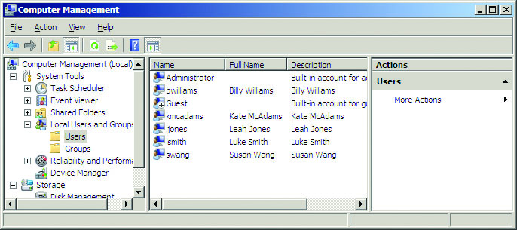
Figure 11.1 Users tab on a Windows Server 2008 system
Notes:
This figure shows the Users management tab of the Computer Management utility on a Windows Server 2008 system. Note that several user accounts have been created on this system, each identified by a unique username.

Slide 15
Group
Under privilege management, a group is a collection of users with some common criteria, such as a need for access to a particular dataset or group of applications.
A new user added to a group will automatically allow that user to access that resource “inherits” the permissions of the group as soon as she is placed in that group.
Some operating systems have built-in groups.
Makes the tasks of assigning and managing permissions easier.
Notes:
A group can consist of one user or hundreds of users, and each user can belong to one or more groups.
By assigning membership in a specific group to a user, you make it much easier to control that user’s access and privileges. For example, if every member of the engineering department needs access to product development documents, administrators can place all the users in the engineering department in a single group and allow that group to access the necessary documents. Once a group is assigned permissions to access a particular resource, adding a new user to that group will automatically allow that user to access that resource.

Slide 16
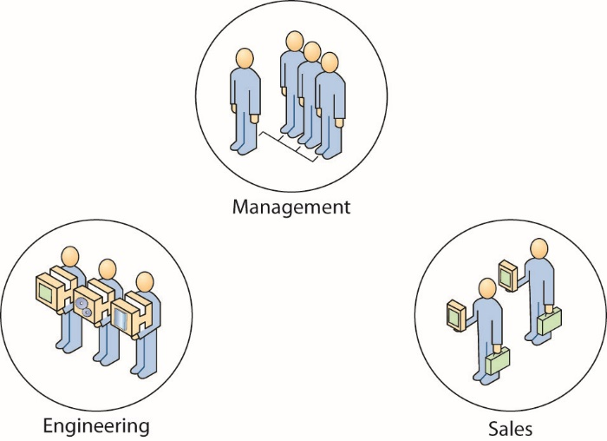
Figure 11.2 Logical representation of groups
Notes:
This figure shows a common approach to grouping users—building groups based on job function.

Slide 17
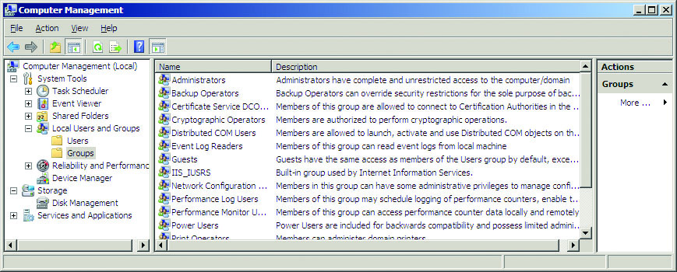
Figure 11.3 Groups tab on a Windows Server 2008 system
Notes:
As this figure shows, a computer system can have many different groups, each with its own rights and permissions.
As you can see from the description for the Administrators group in this figure, this group has complete and unrestricted access to the system. This includes access to all files, applications, and datasets. Anyone who belongs to the Administrators group or is placed in this group will have a great deal of access and control over the system.

Slide 18
Role
A role is usually synonymous with a job or set of functions.
Security admins need to accomplish specific functions
In general, anyone serving in the role of security admin needs the same rights and privileges as every other security admin.
For simplicity and efficiency, rights and privileges can be assigned to the role security admin, and anyone assigned to fulfill that role automatically has the correct rights and privileges to perform the required tasks.
Notes:
For example, the role of security admin in Microsoft SQL Server may be applied to someone who is responsible for creating and managing logins, reading error logs, and auditing the application.

Slide 19
Password Policies
To help users select a good, difficult-to-guess password, most organizations implement and enforce a password policy with these components:
Password construction
Reuse restrictions
Duration
Protection of passwords
Consequences
Notes:
Password policy components:
Password construction How many characters a password should have; the use of capitalization, numbers, and special characters; not basing the password on a dictionary word or personal information; not making the password a slight modification of an existing password; and so on
Reuse restrictions Whether or not passwords can be reused, and, if so, with what frequency (how many different passwords must you use before you can use one you’ve used before)
Duration The minimum and maximum number of days a password can be used before it can be changed or must be changed
Protection of passwords Not writing down passwords where others can find them, not saving passwords and not allowing automated logins, not sharing passwords with other users, and so on
Consequences Consequences associated with violation of or noncompliance with the policy

Slide 20
Domain Password Policy
A domain password policy is a password policy for a specific domain.
The domain controller is a computer that responds to security authentication requests, such as logging into a computer.
The domain password policy usually falls under a group policy object (GPO) and has several elements.
Domains are logical groups of computers that share a central directory database, known as the Active Directory database.
Notes:
The database contains information about the user accounts and security information for all resources identified within the domain. Each user within the domain is assigned his or her own unique account (that is, a domain is not a single account shared by multiple users), which is then assigned access to specific resources within the domain. In operating systems that provide domain capabilities, the password policy is set in the root container for the domain and applies to all users within that domain. Setting a password policy for a domain is similar to setting other password policies in that the same critical elements need to be considered (password length, complexity, life, and so on). If a change to one of these elements is desired for a group of users, a new domain needs to be created because the domain is considered a security boundary. In a Windows operating system that employs Active Directory, the domain password policy can be set in the Active Directory Users and Computers menu in the Administrative Tools section of the Control Panel.

Slide 21
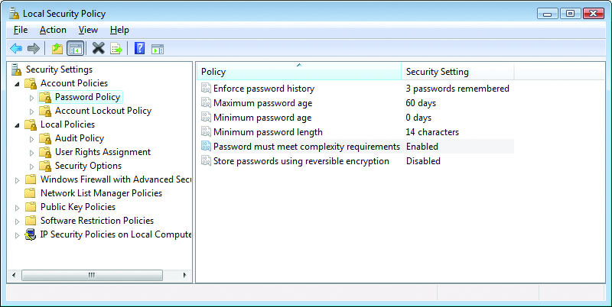
Figure 11.4 Password policy options in Windows Local Security Policy
Notes:
Elements of the group policy object (GPO):
Enforce password history Tells the system how many passwords to remember and does not allow a user to reuse an old password.
Maximum password age Specifies the maximum number of days a password may be used before it must be changed.
Minimum password age Specifies the minimum number of days a password must be used before it can be changed again.
Minimum password length Specifies the minimum number of characters that must be used in a password.
Password must meet complexity requirements Specifies that the password must meet the minimum length requirement and have characters from at least three of the following four groups: English uppercase characters (A through Z), English lowercase characters (a through z), numerals (0 through 9), and non-alphabetic characters (such as !, $, #, %).
Store passwords using reversible encryption Reversible encryption is a form of encryption that can easily be decrypted and is essentially the same as storing a plaintext version of the password (because it’s so easy to reverse the encryption and get the password). This should be used only when applications use protocols that require the user’s password for authentication (such as Challenge-Handshake Authentication Protocol, or CHAP).

Slide 22
Single Sign-On
Single sign-on (SSO) is a form of authentication that involves the transferring of credentials between systems.
Single sign-on allows a user to transfer her credentials, so that logging into one system acts to log her into all of them.
SSO is usually a little more difficult to implement than vendors would lead you to believe.
Notes:
Once the user has entered a user ID and password, the single sign-on system passes these credentials transparently to other systems so that repeated logons are not required. Put simply, you supply the right username and password once and you have access to all the applications and data you need, without having to log in multiple times and remember many different passwords. From a user standpoint, SSO means you need to remember only one username and one password. From an administration standpoint, SSO can be easier to manage and maintain. From a security standpoint, SSO can be even more secure, as users who need to remember only one password are less likely to choose something too simple or something so complex they need to write it down.
In reality, SSO is usually a little more difficult to implement than vendors would lead you to believe. To be effective and useful, all your applications need to be able to access and use the authentication provided by the SSO process. The more diverse your network, the less likely this is to be the case. If your network, like most, contains different operating systems, custom applications, and a diverse user base, SSO may not even be a viable option.

Slide 23
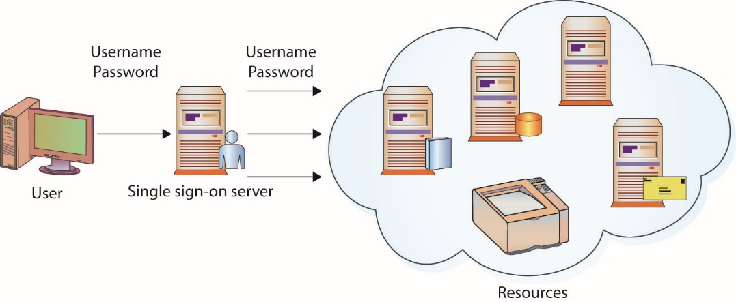
Figure 11.5 Single sign-on process
Notes:
This figure shows a logical depiction of the SSO process:
1. The user signs in once, providing a username and password to the SSO server.
2. The SSO server provides authentication information to any resource the user accesses during that session. The server interfaces with the other applications and systems—the user does not need to log into each system individually.

Slide 24
Time of Day Restrictions
Time of day restrictions limit when a user can log in, when certain resources can be accessed, and so on.
From a security perspective, time of day restrictions can be very useful.
Time of day restrictions can also serve as a mechanism to enforce internal controls of critical or sensitive resources.
A drawback is that a user cannot go to work outside of normal hours to “catch up” with work tasks.

Slide 25
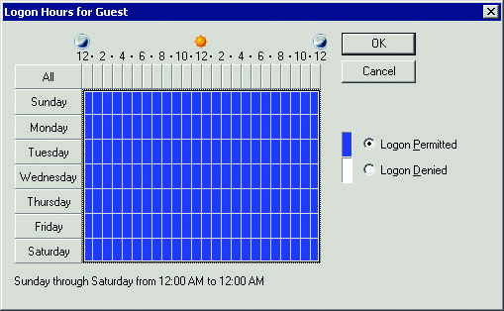
Figure 11.6 Logon hours for Guest account
Notes:
Time of day restrictions are usually specified for individual accounts, as shown in this figure.

Slide 26
Tokens
A token is an authentication factor that typically takes the form of a physical or logical entity that the user must be in possession of to access their account or certain resources.
Physical tokens display a series of numbers that changes every 30 to 90 seconds.
Software tokens still provide two-factor authentication but do not require the user to have a physical device on hand.
Notes:
While the username/password combination has been and continues to be the cheapest and most popular method of controlling access to resources, many organizations look for a more secure and tamper-resistant form of authentication. Usernames and passwords are “something you know” (which can be used by anyone else who knows or discovers the information). A more secure method of authentication is to combine the “something you know” with “something you have.”
Most tokens are physical tokens that display a series of numbers that changes every 30 to 90 seconds, such as the token pictured in Figure 11.7 from Blizzard Entertainment. This sequence of numbers must be entered when the user is attempting to log in or access certain resources. The ever-changing sequence of numbers is synchronized to a remote server such that when the user enters the correct username, password, and matching sequence of numbers, he is allowed to log in. Even if an attacker obtains the username and password, the attacker cannot log in without the matching sequence of numbers. Other physical tokens include Common Access Cards (CACs), USB tokens, smart cards, and PC cards.

Slide 27

Figure 11.7 Token authenticator from Blizzard Entertainment
Notes:
Most tokens are physical tokens that display a series of numbers that changes every 30 to 90 seconds, such as the token pictured in this figure.

Slide 28
Account and Password Expiration
An account expiration or password expiration feature allows administrators to specify a period of time for which a password or an account will be active.
For password expiration, when the expiration date is reached, the user generally is asked to create a new password.
If the password (and thus the account) has been compromised, this helps thwart attackers.
Notes:
Best Practice: Password Expiration One of the best practices an organization can implement is to attach an expiration date to user passwords. This helps ensure that if a password is compromised, the period that the account remains compromised is limited. In most environments and operating systems, this is expressed in terms of the number of days before the password expires and is no longer valid. For example, a maximum password age of 90 days means that a particular password will expire 90 days after that password was initially set to its current value.
If the password (and thus the account) has been compromised when the expiration date is reached and a new password is set, the attacker will again (hopefully) be locked out of the system. The attacker can’t change the password himself, since the user would then be locked out and would contact an administrator to have the password reset, thus again locking out the attacker.
Another attack option would involve the attacker setting a new password on the compromised account and then attempting to reset the account back to the original, compromised password. If the attacker is successful, a new expiration time would be set for the account but the old password would still be used and the user would not be locked out of their account; in most cases, the user wouldn’t notice anything had happened at all as their old password would continue to work. This is one reason why a password history mechanism should be used. The history is used to keep track of previously used passwords so that they cannot be reused.

Slide 29
Security Controls and Permissions
Most operating systems use the concepts of permissions and rights to control and safeguard access to resources.
Windows operating system provides an example.
Uses the concepts of permissions and rights to control access to files, folders, and information resources
Uses user rights or privileges to determine actions a user or group is allowed to perform or access
A very important concept to consider when assigning rights and privileges is the concept of least privilege.
Notes:
If multiple users share a computer system, the system administrator likely needs to control who is allowed to do what when it comes to viewing, using, or changing system resources. While operating systems vary in how they implement these types of controls, most operating systems use the concepts of permissions and rights to control and safeguard access to resources. As we discussed earlier, permissions control what a user is allowed to do with objects on a system and rights define the actions a user can perform on the system itself.
The Windows operating systems use the concepts of permissions and rights to control access to files, folders, and information resources. When using the NTFS file system, administrators can grant users and groups permission to perform certain tasks as they relate to files, folders, and Registry keys.
The basic categories of NTFS permissions are as follows:
Full Control A user/group can change permissions on the folder/file, take ownership if someone else owns the folder/file, delete subfolders and files, and perform actions permitted by all other NTFS folder permissions.
Modify Users/groups can view and modify files/ folders and their properties, can delete and add files/folders, and can delete or add properties to a file/folder.
Read & Execute Users/groups can view the file/folder and can execute scripts and executables but cannot make any changes (files/folders are read-only).
List Folder Contents A user/group can list only what is inside the folder (applies to folders only).
Read Users/groups can view the contents of the file/folder and the file/folder properties.
Write Users/groups can write to the file
The Windows operating system also uses user rights or privileges to determine what actions a user or group is allowed to perform or access. These user rights are typically assigned to groups, as it is easier to deal with a few groups than to assign rights to individual users, and they are usually defined in either a group or a local security policy.
The list of user rights is quite extensive but a few examples of user rights are:
Log on locally Users/groups can attempt to log onto the local system itself.
Access this computer from the network Users/groups can attempt to access this system through the network connection.
Manage auditing and security log Users/groups can view, modify, and delete auditing and security log information.
Least privilege requires that users be given the absolute minimum number of rights and privileges required to perform their authorized duties. For example, if a user does not need the ability to install software on their own desktop to perform their job, then don’t give them that ability. This reduces the likelihood the user will load malware, insecure software, or unauthorized applications onto their system.

Slide 30
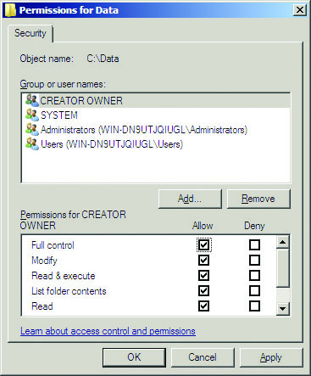
Figure 11.8 Permissions for the Data folder
Notes:
This figure shows the permissions on a folder called Data from a Windows Server system. In the top half of the Permissions window are the users and groups that have permissions for this folder. In the bottom half of the window are the permissions assigned to the highlighted user or group.

Slide 31
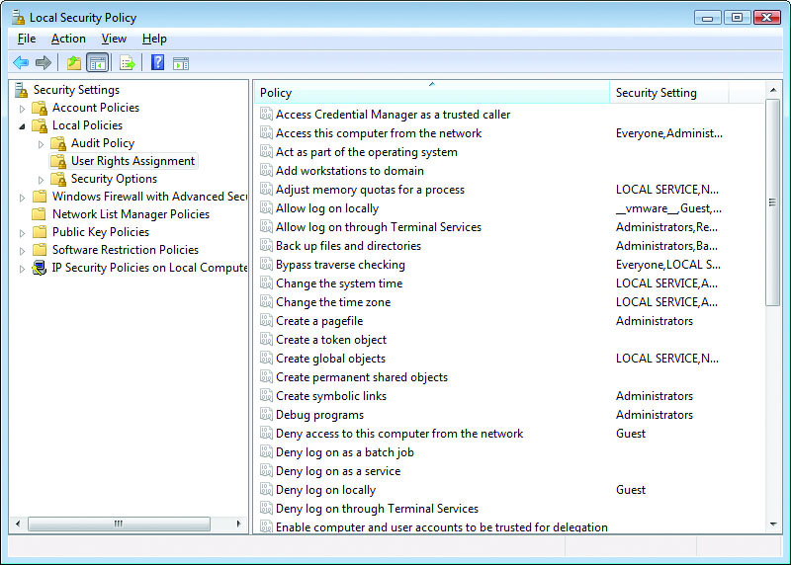
Figure 11.9 User Rights Assignment options from Windows Local Security Policy
Notes:
Rights tend to be actions that deal with accessing the system itself, process control, logging, and so on. This figure shows the user rights contained in the local security policy on a Windows system.
Exam Tip: Although it is very important to get security settings “right the first time,” it is just as important to perform routine audits of security settings such as user accounts, group memberships, file permissions, and so on.

Slide 32
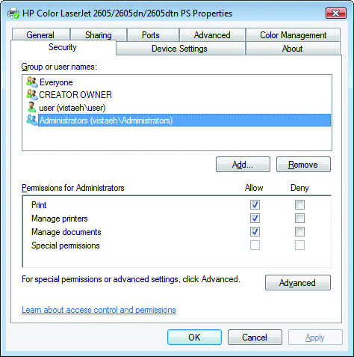
Figure 11.10 Security tab showing printer permissions in Windows
Notes:
Folders and files are not the only things that can be safeguarded or controlled using permissions. Even access and use of peripherals, such as printers, can be controlled using permissions. This figure shows the Security tab from a printer attached to a Windows system. Permissions can be assigned to control who can print to the printer, who can manage documents and print jobs sent to the printer, and who can manage the printer itself. With this type of granular control, administrators have a great deal of control over how system resources are used and who uses them.

Slide 33
Access Control Lists
Access control list (ACL) is used in more than one manner in the field of computer security.
Routers and firewalls: An ACL is a set of rules used to control traffic flow into or out of an interface or network.
System resources: An ACL lists permissions attached to an object.
An access control matrix provides the simplest framework for illustrating the process.
Seldom used in computer systems because it is extremely costly in terms of storage space and processing

Slide 34
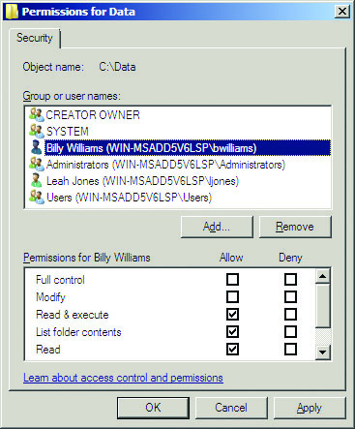
Figure 11.11 Permissions for Billy Williams on the Data folder
Notes:
This figure shows the access control list (permissions) for the Data folder. The user identified as Billy Williams has Read & Execute, List Folder Contents, and Read permissions, meaning this user can open the folder, see what’s in the folder, and so on.

Slide 35
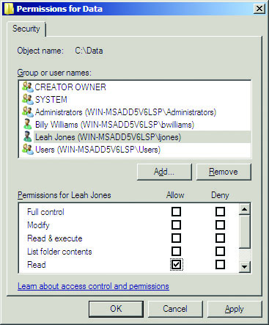
Figure 11.12 Permissions for Leah Jones on the Data folder
Notes:
This figure shows the permissions for a user identified as Leah Jones, who has only Read permissions on the same folder.

Slide 36
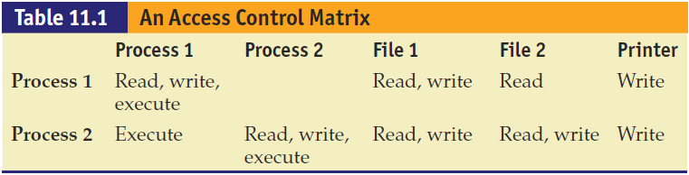

Slide 37
Mandatory Access Control (MAC)
Mandatory access control (MAC) is the process of controlling access to information based on the sensitivity of that information and whether or not the user is operating at the appropriate sensitivity level and has the authority to access that information.
Information and resources labeled with a sensitivity level
Users assigned a clearance level
Access control and sensitivity labels required in a MAC system
Notes:
Under a MAC system, each piece of information and every system resource (files, devices, networks, and so on) is labeled with its sensitivity level (such as Public, Engineering Private, Jones Secret). Users are assigned a clearance level that sets the upper boundary of the information and devices that they are allowed to access. The access control and sensitivity labels are required in a MAC system. Labels are defined and then assigned to users and resources. Users must then operate within their assigned sensitivity and clearance levels—they don’t have the option to modify their own sensitivity levels or the levels of the information resources they create. Due to the complexity involved, MAC is typically run only on systems where security is a top priority such as Trusted Solaris, OpenBSD, and SELinux.
Exam Tip: Mandatory access control restricts access based on the sensitivity of the information and whether or not the user has the authority to access that information.

Slide 38
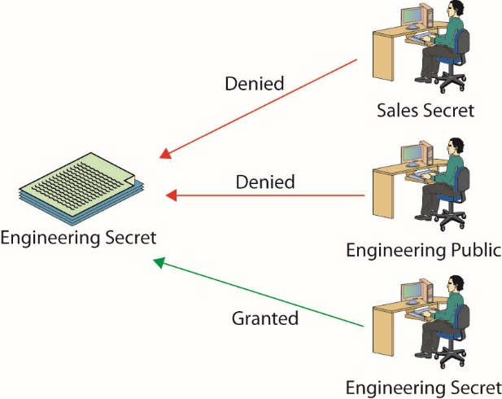
Figure 11.13 Logical representation of mandatory access control
Notes:
This figure illustrates MAC in operation. The information resource on the left has been labeled “Engineering Secret,” meaning only users in the Engineering group operating at the Secret sensitivity level or above can access that resource. The top user is operating at the Secret level but is not a member of Engineering and is denied access to the resource. The middle user is a member of Engineering but is operating at a Public sensitivity level and is therefore denied access to the resource. The bottom user is a member of Engineering, is operating at a Secret sensitivity level, and is allowed to access the information resource.

Slide 39
Discretionary Access Control
Discretionary access control (DAC) is the process of using file permissions and optional ACLs to restrict access to information based on a user’s identity or group membership.
Most common access control system and is commonly used in both UNIX and Windows operating systems.
Under the DAC model, the file’s owner can change the file’s permissions any time he wants.
Notes:
Under UNIX operating systems, file permissions consist of three distinct parts:
Owner permissions (read, write, and execute) The owner of the file
Group permissions (read, write, and execute) The group to which the owner of the file belongs
World permissions (read, write, and execute) Anyone else who is not the owner and does not belong to the group to which the owner of the file belongs

Slide 40
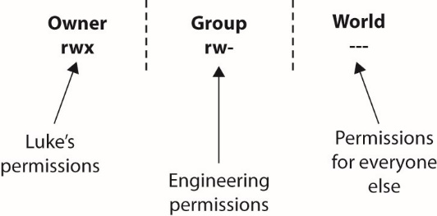
Figure 11.14 Discretionary file permissions in the UNIX environment
Notes:
In UNIX, a file’s permissions are usually displayed as a series of nine characters, with the first three characters representing the owner’s permissions, the second three characters representing the group permissions, and the last three characters representing the permissions for everyone else, or for the world. This concept is illustrated in this figure.
Suppose the file secretdata is owned by Luke with group permissions for Engineering (because Luke is part of the Engineering group), and the permissions on that file are rwx, rw-, and ---, as shown in this figure. This would mean that:
Luke can read, write, and execute the file (rwx).
Members of the Engineering group can read and write the file but not execute it (rw-).
The world has no access to the file and cannot read, write, or execute it (---).

Slide 41
Role-Based Access Control (RBAC)
Role-based access control (RBAC) is the process of managing access and privileges based on the user’s assigned roles.
RBAC is the access control model that most closely resembles an organization’s structure.
Under RBAC, you must first determine the activities that must be performed and the resources that must be accessed.
When a role is assigned to a specific user, the user gets all the rights and privileges assigned to that role.
Notes:
In this scheme, instead of each user being assigned specific access permissions for the objects associated with the computer system or network, that user is assigned a set of roles that the user may perform. The roles are in turn assigned the access permissions necessary to perform the tasks associated with the role. Users will thus be granted permissions to objects in terms of the specific duties they must perform—not just because of a security classification associated with individual objects.
Unfortunately, in reality, administrators often find themselves in a position of working in an organization where more than one user has multiple roles or even access to multiple accounts (a situation quite common in smaller organizations). Users with multiple accounts tend to select the same or similar passwords for those accounts, thereby increasing the chance one compromised account can lead to the compromise of other accounts accessed by that user. Where possible, administrators should first eliminate shared or additional accounts for users and then examine the possibility of combining roles or privileges to reduce the “account footprint” of individual users.

Slide 42
Rule-Based Access Control
In rule-based access control, access is either allowed or denied based on a set of predefined rules.
Each object has an associated ACL (much like DAC), and when a particular user or group attempts to access the object, the appropriate rule is applied.
A good example for rule-based access control is permitted logon hours.
Many operating systems give administrators the ability to control the hours during which users can log in.
Notes:
Rule-based access control is yet another method of managing access and privileges (and unfortunately shares the same acronym as role-based access control). In this method, access is either allowed or denied based on a set of predefined rules. Each object has an associated ACL (much like DAC), and when a particular user or group attempts to access the object, the appropriate rule is applied. A good example for rule-based access control is permitted logon hours.
Many operating systems give administrators the ability to control the hours during which users can log in. For example, a bank may allow its employees to log in only between the hours of 8 A.M. and 6 P.M. Monday through Saturday. If a user attempts to log in outside of these hours, 3 A.M. on Sunday for example, then the rule will reject the login attempt whether or not the user supplies valid login credentials.
Exam Tip: Role-based and rule-based access control can both be abbreviated as RBAC. Standard convention is for RBAC to be used to denote role-based access control. A seldom-seen acronym for rule-based access control is RB-RBAC. Role-based focuses on the user’s role (administrator, backup operator, and so on). Rule-based focuses on predefined criteria such as time of day (users can only log in between 8 A.M. and 6 P.M.) or type of network traffic (web traffic is allowed to leave the organization).

Slide 43
Attribute-Based Access Control (ABAC)
Attribute-based access control (ABAC) is a new access control schema based on the use of attributes associated with an identity.
These can use any type of attributes.
User attributes, resource attributes, environment attributes, and so on
ABAC can be represented via the eXtensible Access Control Markup Language (XACML), a standard that implements attribute- and policy-based access control schemes.

Slide 44
Account Expiration
Operating systems allow administrators to specify the length of time an account is valid and when it “expires” or is disabled.
Great for controlling temporary accounts
Organizations must define whether accounts are deleted or disabled when no longer needed.
Deleting an account removes the account from the system permanently.
Disabling an account leaves it in place but marks it as unusable.
Notes:
This is a great method for controlling temporary accounts, or accounts for contractors or contract employees. For these accounts, the administrator can specify an expiration date; when the date is reached, the account automatically becomes locked out and cannot be logged into without administrator intervention. A related action can be taken with accounts that never expire: they can automatically be marked “inactive” and locked out if they have been unused for a specified number of days. Account expiration is similar to password expiration, in that it limits the time window of potential compromise. When an account has expired, it cannot be used unless the expiration deadline is extended.
Many organizations disable accounts for a period of time after an employee departs (30 or more days) prior to deleting the account. This prevents anyone from using the account and allows administrators to reassign files, forward mail, and “clean up” before taking any permanent actions on the account.

Slide 45
Preventing Data Loss or Theft
Today’s hackers are after intellectual property, business plans, competitive intelligence, personal information, credit card numbers, client records, or any other information that can be sold, traded, or manipulated for profit.
This has created a whole industry of technical solutions labeled data loss prevention (DLP) solutions.
The best DLP solution is a combination of security elements, some to secure data in storage (encryption) and some in the form of monitoring.

Slide 46
The Remote Access Process
The three steps in the establishment of proper privileges are authentication, authorization, and accounting, referred to as AAA.
Authentication is the matching of user-supplied credentials to previously stored credentials on a host machine, and it usually involves an account username and password.
Authorization is the granting of specific permissions based on the privileges held by the account.

Slide 47
The Remote Access Process (continued)
Accounting is the collection of billing and other detail records.
Once the user is authenticated, the authorization step takes place.
Remote authentication usually takes the common form of an end user submitting his credentials via an established protocol to a remote access server (RAS), which acts upon those credentials, either granting or denying access.

Slide 48
Identification
Identification is the process of ascribing a computer ID to a specific user, computer, network device, or computer process.
The identification process is typically performed only once, when a user ID is issued to a particular user.
User identification enables authentication and authorization to form the basis for accountability.
For accountability purposes, user IDs should not be shared, and for security purposes, they should not be descriptive of job function.
Notes:
This practice enables you to trace activities to individual users or computer processes so that they can be held responsible for their actions. Identification links the logon ID or user ID to credentials that have been submitted previously to either HR or the IT staff. A required characteristic of user IDs is that they must be unique so that they map back to the credentials presented when the account was established.

Slide 49
Authentication
Authentication is the process of binding a specific ID to a specific computer connection.
Two items need to be presented to cause this binding to occur—the user ID, and some “secret” to prove that the user is the valid possessor of the credentials.
Historically, three categories of secrets are used to authenticate the identity of a user:
What users know, what users have, and what users are
Today, an additional category is used: what users do.
Notes:
These methods can be used individually or in combination. These controls assume that the identification process has been completed and the identity of the user has been verified. It is the job of authentication mechanisms to ensure that only valid users are admitted. Described another way, authentication is using some mechanism to prove that you are who you claimed to be when the identification process was completed.
For greater security, you can add an element from a separate group, such as a smart card token—something a user has in her possession. Passwords are common because they are one of the simplest forms and use user memory as a prime component. Because of their simplicity, passwords have become ubiquitous across a wide range of authentication systems.

Slide 50
Authentication (continued)
Password is most common authentication method.
An element from a separate group can be added for greater security, such as a smart card token—something a user has in her possession.
Another method to provide authentication involves the use of something that only valid users should have in their possession.
The third general method to provide authentication involves something that is unique about you.
Notes:
A new method, based on how users perform an action, such as their gait when walking, or typing patterns has emerged as a source of a personal “signature”.

Slide 51
Authentication (continued)
Basic authentication is the simplest technique used to manage access control across HTTP.
Basic authentication operates by passing information encoded in Base64 form using standard HTTP headers.
This is a plaintext method without any pretense of security.

Slide 52
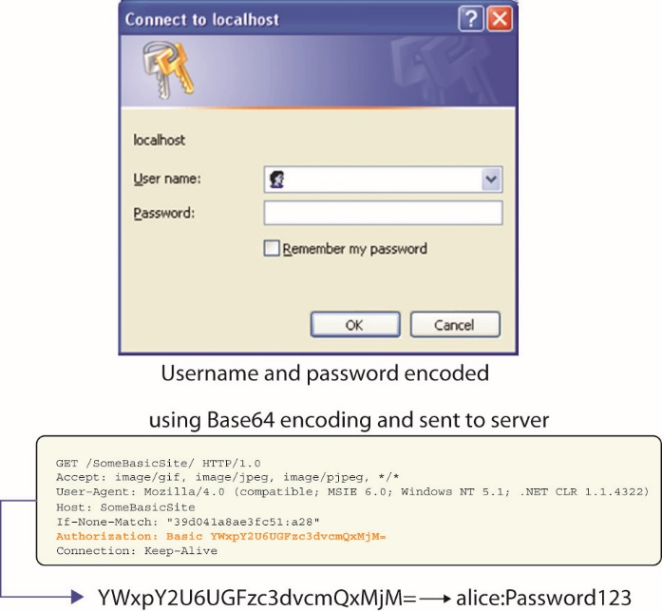
Figure 11.15 How basic authentication operates
Notes:
This figure illustrates the operation of basic authentication.

Slide 53
Authentication (continued)
Digest authentication is a method used to negotiate credentials across the Web.
Digest authentication uses hash functions and a nonce to improve security over basic authentication.
Digest authentication, although it improves security over basic authentication, does not provide any significant level of security.
Passwords are not sent in the clear.
Digest authentication is subject to man-in-the-middle attacks and potentially replay attacks.

Slide 54
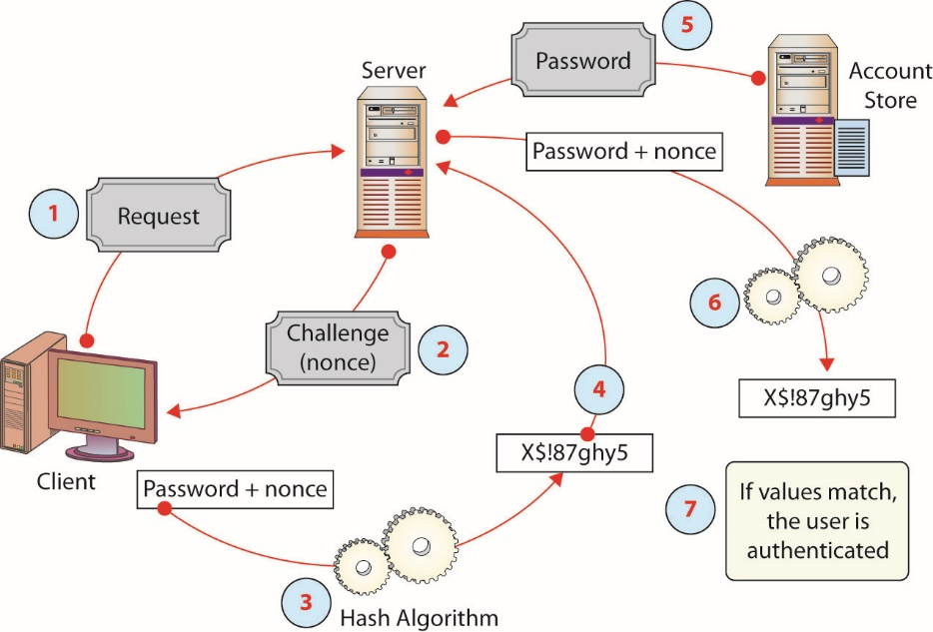
Figure 11.16 How digest authentication operates
Notes:
Authentication works as follows, as illustrated in this figure:
1. The client requests login.
2. The server responds with a challenge and provides a nonce.
3. The client hashes the password and nonce.
4. The client returns the hashed password to the server.
5. The server requests the password from a password store.
6. The server hashes the password and nonce.
7. If both hashes match, login is granted.

Slide 55
Authentication (continued)
Kerberos is a network authentication protocol designed for a client/server environment.
Kerberos is built around the idea of a trusted third party, termed a key distribution center (KDC), which consists of two logically separate parts: an authentication server (AS) and a ticket-granting server (TGS).
Kerberos communicates via “tickets” that serve to prove the identity of users.
The basis for authentication in a Kerberos environment is the ticket.
Tickets are used in a two-step process with the client.
Notes:
Developed as part of MIT’s project Athena, Kerberos is a network authentication protocol designed for a client/server environment. The current version is Kerberos 5 release 1.13.2 and is supported by all major operating systems.
Taking its name from the three-headed dog of Greek mythology, Kerberos is designed to work across the Internet, an inherently insecure environment. Kerberos uses strong encryption so that a client can prove its identity to a server and the server can in turn authenticate itself to the client. A complete Kerberos environment is referred to as a Kerberos realm. The Kerberos server contains user IDs and hashed passwords for all users that will have authorizations to realm services. The Kerberos server also has shared secret keys with every server to which it will grant access tickets.

Slide 56
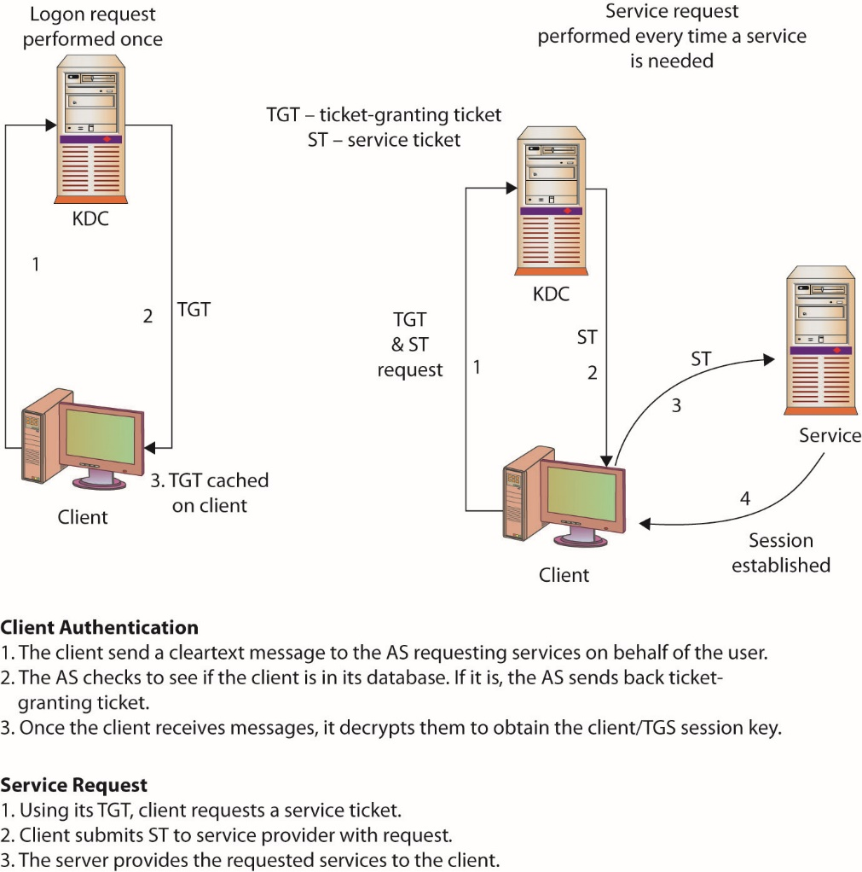
Figure 11.17 Kerberos operations
Notes:
The basis for authentication in a Kerberos environment is the ticket.
Tickets are used in a two-step process with the client. The first ticket is a ticket-granting ticket (TGT) issued by the AS to a requesting client. The client can then present this ticket to the Kerberos server with a request for a ticket to access a specific server. This client-to-server ticket (also called a service ticket) is used to gain access to a server’s service in the realm.
Since the entire session can be encrypted, this eliminates the inherently insecure transmission of items such as a password that can be intercepted on the network. Tickets are time-stamped and have a lifetime, so attempting to reuse a ticket will not be successful. This figure details Kerberos operations.

Slide 57
Authentication (continued)
Certificates are a method of establishing authenticity of specific objects such as an individual’s public key or downloaded software.
A digital certificate is a digital file that is sent as an attachment to a message and is used to verify that the message did indeed come from the entity it claims to have come from.

Slide 58
Authentication (continued)
A token is a hardware device that can be used in a challenge/response authentication process.
It functions as both a something-you-have and something-you-know authentication mechanism.
Several variations on this type of device exist.
All work on the same basic principles.
Tokens are commonly employed in remote authentication schemes as they provide additional surety of the identity of the user, even users who are somewhere else and cannot be observed.
Notes:
Exam Tip: The use of a token is a common method of using “something you have” for authentication. A token can hold a cryptographic key or act as a one-time password (OTP) generator. It can also be a smart card that holds a cryptographic key (examples include the U.S. military Common Access Card and the Federal Personal Identity Verification [PIV] card). These devices can be safeguarded using a PIN and lockout mechanism to prevent use if stolen.

Slide 59
Authentication (continued)
Multifactor authentication is a term that describes the use of more than one authentication mechanism at the same time.
Something-you-have and something-you-know mechanisms are used as factors in verifying authenticity of the user.
Biometrics used in conjunction with a PIN
Purpose: increases the level of security
Example: ATM card and PIN
Also known as two-factor or three-factor authentication
Notes:
Exam Tip: The required use of more than one authentication system is known as multifactor authentication. The most common example is the combination of a password with a hardware token. For high security, three factors can be used: password, token, and biometric.

Slide 60
Authentication (continued)
Mutual authentication describes a process in which each side of an electronic communication verifies the authenticity of the other.
This provides a mechanism for each side of a client/server relationship to verify the authenticity of the other to address this issue.
A common method of performing mutual authentication involves using a secure connection, such as Transport Layer Security (TLS), to the server and a one-time password generator that then authenticates the client.

Slide 61
Authorization
Authorization is the process of permitting or denying access to a specific resource.
Once identity is confirmed via authentication, specific actions can be authorized or denied.
Purpose is to determine whether a given user who has been identified has permissions for a particular object or resource being requested.
Functionality is frequently part of the operating system and is transparent to users.
The separation of tasks has several advantages.
Notes:
The separation of tasks, from identification to authentication to authorization, has several advantages. Many methods can be used to perform each task, and on many systems several methods are concurrently present for each task. Separation of these tasks into individual elements allows combinations of implementations to work together. Any system or resource, be it hardware (router or workstation) or a software component (database system), that requires authorization can use its own authorization method once authentication has occurred. This makes for efficient and consistent application of these principles.

Slide 62
Module 6 Authentication and Remote Access and Intrusion Detection Systems and Network Security – Part 2

Slide 63
Access Control
The term access control has been used to describe a variety of protection schemes.
It sometimes refers to all security features used to prevent unauthorized access to a computer system or network—or even a network resource, such as a printer.
More properly, access is the ability of a subject to interact with an object.
Once the individual has verified their identity, access controls regulate what the individual can actually do on the system.
Notes:
Just because a person is granted entry to the system, that does not mean that they should have access to all data the system contains.

Slide 64
Remote Access Methods
When a user requires access to a remote system, the process of remote access is used to determine the appropriate controls.

Slide 65
IEEE 802.1x
IEEE 802.1X is an authentication standard that supports port-based authentication services between a user and an authorization device, such as an edge router.
Used by all types of networks
Describes methods used to authenticate a user prior to granting access to a network and the authentication server, such as a RADIUS server
Acts through an intermediate device, such as an edge switch, enabling ports to carry normal traffic if the connection is properly authenticated
Notes:
IEEE 802.1X is used by all types of networks, including Ethernet, Token Ring, and wireless. This standard describes methods used to authenticate a user prior to granting access to a network and the authentication server, such as a RADIUS server. 802.1X acts through an intermediate device, such as an edge switch, enabling ports to carry normal traffic if the connection is properly authenticated. This prevents unauthorized clients from accessing the publicly available ports on a switch, keeping unauthorized users out of a LAN. Until a client has successfully authenticated itself to the device, only Extensible Authentication Protocol over LAN (EAPOL) traffic is passed by the switch.
EAPOL is an encapsulated method of passing EAP messages over 802.1 frames. EAP is a general protocol that can support multiple methods of authentication, including one-time passwords, Kerberos, public keys, and security device methods such as smart cards. Once a client successfully authenticates itself to the 802.1X device, the switch opens ports for normal traffic. At this point, the client can communicate with the system’s AAA method, such as a RADIUS server, and authenticate itself to the network.

Slide 66
IEEE 802.1x (continued)
Until a client has successfully authenticated itself to the device, only Extensible Authentication Protocol over LAN (EAPOL) traffic is passed by the switch.
EAPOL is an encapsulated method of passing EAP messages over 802.1 frames.
IEEE 802.1X is commonly used on wireless access points as a port-based authentication service prior to admission to the wireless network.
802.1X over wireless uses either 802.11i or EAP-based protocols, such as EAP-TLS or PEAP-TLS.
Notes:
EAP is a general protocol that can support multiple methods of authentication, including one-time passwords, Kerberos, public keys, and security device methods such as smart cards. Once a client successfully authenticates itself to the 802.1X device, the switch opens ports for normal traffic. At this point, the client can communicate with the system’s AAA method, such as a RADIUS server, and authenticate itself to the network.

Slide 67
RADIUS
Remote Authentication Dial-In User Service (RADIUS) is an AAA protocol.
Designed as a connectionless protocol
UDP employed as its transport layer protocol
Connection issues handled by the RADIUS application
A client/server protocol
Client is typically a network access server (NAS).
Server is a process or daemon.
Communications between a user and the RADIUS client are subject to compromise.
Notes:
It was submitted to the Internet Engineering Task Force (IETF) as a series of RFCs: RFC 2058 (RADIUS specification), RFC 2059 (RADIUS accounting standard), and updated RFCs 2865–2869, which are now standard protocols.
RADIUS utilizes UDP port 1812 for authentication and authorization and UDP 1813 for accounting functions.
Network access servers act as intermediaries, authenticating clients before allowing them access to a network. RADIUS, RRAS (Microsoft), RAS, and VPN servers can all act as network access servers.
The RADIUS server is a process or daemon running on a UNIX or Windows Server machine. Communications between a RADIUS client and RADIUS server are encrypted using a shared secret that is manually configured into each entity and not shared over a connection. Hence, communications between a RADIUS client (typically a NAS) and a RADIUS server are secure, but the communications between a user (typically a PC) and the RADIUS client are subject to compromise.
This is important to note, for if the user’s machine (the PC) is not the RADIUS client (the NAS), then communications between the PC and the NAS are typically not encrypted and are passed in the clear.

Slide 68
RADIUS (continued)
RADIUS authentication
When the server is given a username and password, it can support Point-to-Point Protocol (PPP), Password Authentication Protocol (PAP), Challenge-Handshake Authentication Protocol (CHAP), UNIX login, and other mechanisms, depending on what was established when the server was set up.
A user login authentication consists of a query (Access-Request) from the RADIUS client and a corresponding response (Access-Accept, Access-Challenge, or Access-Reject) from the RADIUS server.

Slide 69
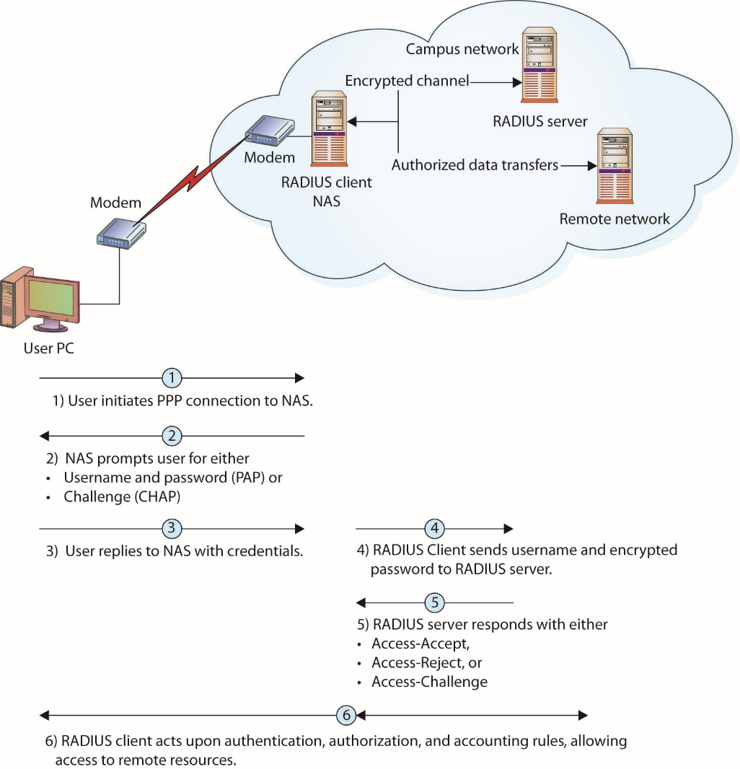
Figure 11.18 RADIUS communication sequence
Notes:
A user login authentication consists of a query (Access-Request) from the RADIUS client and a corresponding response (Access-Accept, Access-Challenge, or Access-Reject) from the RADIUS server, as you can see in this figure.
The Access-Challenge response is the initiation of a challenge/response handshake. If the client cannot support challenge/response, then it treats the Challenge message as an Access-Reject.
The Access-Request message contains the username, encrypted password, NAS IP address, and port. The message also contains information concerning the type of session the user wants to initiate. Once the RADIUS server receives this information, it searches its database for a match on the username. If a match is not found, either a default profile is loaded or an Access-Reject reply is sent to the user. If the entry is found or the default profile is used, the next phase involves authorization, for in RADIUS, these steps are performed in sequence.
This figure shows the interaction between a user and the RADIUS client and RADIUS server and the steps taken to make a connection.

Slide 70
RADIUS (continued)
RADIUS authorization
The authentication and authorization steps are performed together in response to a single Access-Request message, although they are sequential steps.
Once an identity has been established, either known or default, the authorization process determines what parameters are returned to the client.
Typical parameters include: service type allowed, protocols allowed, IP address to assign to the user, and access list to apply or static route to place in the NAS routing table.
Notes:
These parameters are all defined in the configuration information on the RADIUS client and server during setup. Using this information, the RADIUS server returns an Access-Accept message with these parameters to the RADIUS client.

Slide 71
RADIUS (continued)
RADIUS accounting
Performed independently of RADIUS authentication and authorization
Uses a separate UDP port, 1813
Established to support ISPs in their user accounting; supports typical accounting functions for time billing and security logging
Designed to allow data to be transmitted at the beginning and end of a session, and they can indicate resource utilization, such as time, bandwidth, and so on

Slide 72
RADIUS (continued)
Diameter
Name of an AAA protocol suite, designated by the IETF to replace the aging RADIUS protocol
Operates like RADIUS in a client/server configuration
Improves upon RADIUS, resolving discovered weaknesses
A TCP-based service
More extensive AAA capabilities
Designed for all types of remote access
Improved method of encrypting message exchanges to prohibit replay and man-in-the-middle attacks
Notes:
Taken all together, Diameter, with its enhanced functionality and security, is an improvement on the proven design of the old RADIUS standard.

Slide 73
Terminal Access Controller Access Control System+ (TACACS+)
Fundamental design aspect is the separation of authentication, authorization, and accounting.
TACACS+ uses TCP as its transport protocol, typically operating over TCP port 49.
It is a client/server protocol, with the client typically being a NAS and the server being a daemon process on a UNIX, Linux, or Windows server.
Communications between PC and NAS may not be encrypted.
Notes:
The Terminal Access Controller Access Control System+ (TACACS+) protocol is the current generation of the TACACS family. Originally TACACS was developed by BBN Planet Corporation for MILNET, an early military network, but it has been enhanced by Cisco, which has expanded its functionality twice. The original BBN TACACS system provided a combination process of authentication and authorization. Cisco extended this to Extended Terminal Access Controller Access Control System (XTACACS), which provided for separate authentication, authorization, and accounting processes. The current generation, TACACS+, has extended attribute control and accounting processes.
One of the fundamental design aspects is the separation of authentication, authorization, and accounting in this protocol. Although there is a straightforward lineage of these protocols from the original TACACS, TACACS+ is a major revision and is not backward-compatible with previous versions of the protocol series.
TACACS+ uses TCP as its transport protocol, typically operating over TCP port 49. This port is used for the login process and is reserved in RFC 3232, “Assigned Numbers,” manifested in a database from the Internet Assigned Numbers Authority (IANA). In the IANA specification, both UDP port 49 and TCP port 49 are reserved for the TACACS+ login host protocol (see Table 11.2 in the “Connection Summary” section at the end of the chapter).
TACACS+ is a client/server protocol, with the client typically being a NAS and the server being a daemon process on a UNIX, Linux, or Windows server.
This is important to note, for if the user’s machine (usually a PC) is not the client (usually a NAS), then communications between PC and NAS are typically not encrypted and are passed in the clear. Communications between a TACACS+ client and TACACS+ server are encrypted using a shared secret that is manually configured into each entity and is not shared over a connection. Hence, communications between a TACACS+ client (typically a NAS) and a TACACS+ server are secure, but the communications between a user (typically a PC) and the TACACS+ client are subject to compromise.

Slide 74
TACACS+ (continued)
TACACS+ authentication
TACACS+ allows for arbitrary length and content in the authentication exchange sequence, enabling many different authentication mechanisms to be used with TACACS+ clients.
Authentication is optional and is determined as a site-configurable option.
When authentication is used, common forms include PPP PAP, PPP CHAP, PPP EAP, token cards, and Kerberos.
The authentication process is performed using three different packet types: START, CONTINUE, and REPLY.
Notes:
The authentication process is performed using three different packet types: START, CONTINUE, and REPLY.
START and CONTINUE packets originate from the client and are directed to the TACACS+ server. The REPLY packet is used to communicate from the TACACS+ server to the client.

Slide 75
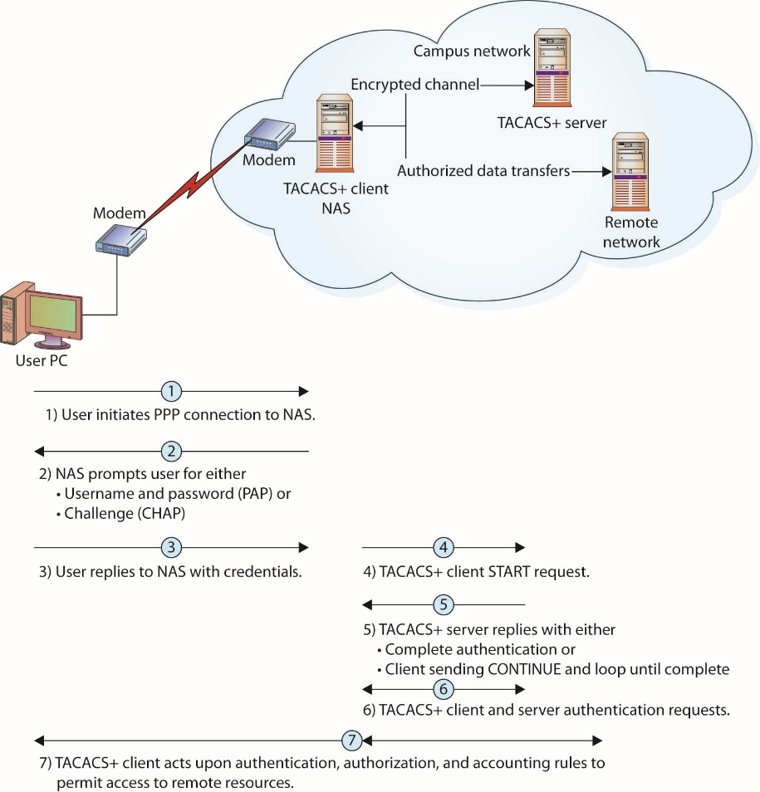
Figure 11.19 TACACS+ communication sequence
Notes:
The authentication process is illustrated in in this figure, and it begins with a START message from the client to the server. This message may be in response to an initiation from a PC connected to the TACACS+ client. The START message describes the type of authentication being requested (simple plaintext password, PAP, CHAP, and so on). This START message may also contain additional authentication data, such as a username and password. A START message is also sent as a response to a restart request from the server in a REPLY message. A START message always has its sequence number set to 1.
When a TACACS+ server receives a START message, it sends a REPLY message. This REPLY message indicates whether the authentication is complete or needs to be continued. If the process needs to be continued, the REPLY message also specifies what additional information is needed. The response from a client to a REPLY message requesting additional data is a CONTINUE message. This process continues until the server has all the information needed, and the authentication process concludes with a success or failure.

Slide 76
TACACS+ (continued)
TACACS+ authorization
Defined as the granting of specific permissions based on the privileges held by the account
Generally occurs after authentication, but not a firm requirement
An optional process and may or may not be part of a site-specific operation
Performed using two message types: REQUEST and RESPONSE
Notes:
A default state of “unknown user” exists before a user is authenticated, and permissions can be determined for an unknown user.
When it is used in conjunction with authentication, the authorization process follows the authentication process and uses the confirmed user identity as input in the decision process.
The authorization process is performed using two message types: REQUEST and RESPONSE. The authorization process is performed using an authorization session consisting of a single pair of REQUEST and RESPONSE messages. The client issues an authorization REQUEST message containing a fixed set of fields enumerating the authenticity of the user or process requesting permission and a variable set of fields enumerating the services or options for which authorization is being requested.
The RESPONSE message in TACACS+ is not a simple yes or no; it can also include qualifying information, such as a user time limit or IP restrictions. These limitations have important uses, such as enforcing time limits on shell access or enforcing IP access list restrictions for specific user accounts.

Slide 77
TACACS+ (continued)
TACACS+ accounting
An optional function of TACACS+
Defined as the process of recording what a user or process has done
Serves two important purposes:
It can be used to account for services being utilized, possibly for billing purposes.
It can be used for generating security audit trails.
Three types of accounting records: START, STOP, and UPDATE
Notes:
TACACS+ accounting records contain several pieces of information to support these tasks. The accounting process has the information revealed in the authorization and authentication processes, so it can record specific requests by user or process. To support this functionality, TACACS+ has three types of accounting records: START, STOP, and UPDATE. Note that these are record types, not message types as earlier discussed.

Slide 78
Authentication Protocols
Numerous authentication protocols have been developed.
Some did not enjoy market share.
Others have had security issues.
Others have been revised and improved in newer versions.

Slide 79
Authentication Protocols (continued)
L2TP and PPTP
Layer 2 Tunneling Protocol (L2TP) and Point-to-Point Tunneling Protocol (PPTP) are both OSI Layer 2 tunneling protocols.
Tunneling is the encapsulation of one packet within another.
This allows you to hide the original packet from view.
This can be done for both security and practical reasons.
Notes:
From a practical perspective, assume that you are using TCP/IP to communicate between two machines. Your message may pass over various networks, such as an Asynchronous Transfer Mode (ATM) network, as it moves from source to destination. As the ATM protocol can neither read nor understand TCP/IP packets, something must be done to make them passable across the network. By encapsulating a packet as the payload in a separate protocol, so it can be carried across a section of a network, a mechanism called a tunnel is created. At each end of the tunnel, called the tunnel endpoints, the payload packet is read and understood. As it goes into the tunnel, you can envision your packet being placed in an envelope with the address of the appropriate tunnel endpoint on the envelope. When the envelope arrives at the tunnel endpoint, the original message (the tunnel packet’s payload) is re-created, read, and sent to its appropriate next stop. The information being tunneled is understood only at the tunnel endpoints; it is not relevant to intermediate tunnel points because it is only a payload.

Slide 80
Authentication Protocols (continued)
Point-to-Point Protocol (PPP) is an older, still widely used protocol for establishing dial-in connections over serial lines or Integrated Services Digital Network (ISDN) services.
PPP has several authentication mechanisms: PAP, CHAP, and the Extensible Authentication Protocol (EAP).
Protocols used to authenticate the peer device
PPP is a standardized Internet encapsulation of IP traffic over point-to-point links, such as serial lines.
The authentication process is performed only when the link is established.

Slide 81
Authentication Protocols (continued)
Point-to-Point Tunneling (PPTP) is a network protocol that enables the secure transfer of data from a remote PC to a server by creating a VPN across a TCP/IP network.
It can also span a public switched telephone network (PSTN) and is thus an economical way of connecting remote dial-in users to a corporate data network.
For most PPTP implementations, three computers are involved: the PPTP client, the NAS, and a PPTP server.
The connection between the remote client and the network is established in stages.
Notes:
The incorporation of PPTP into the Microsoft Windows product line provides a built-in secure method of remote connection using the operating system, and this has given PPTP a large marketplace footprint.
For most PPTP implementations, three computers are involved: the PPTP client, the NAS, and a PPTP server. The connection between the remote client and the network is established in stages.
PPTP establishes a tunnel from the remote PPTP client to the PPTP server and enables encryption within this tunnel. This provides a secure method of transport. To do this and still enable routing, an intermediate addressing scheme, Generic Routing Encapsulation (GRE), is used. To establish the connection, PPTP uses communications across TCP port 1723 (see Table 11.2 in the “Connection Summary” section at the end of the chapter), so this port must remain open across the network firewalls for PPTP to be initiated. Although PPTP allows the use of any PPP authentication scheme, CHAP is used when encryption is specified, to provide an appropriate level of security. For the encryption methodology, Microsoft chose the RSA RC4 cipher, with either a 40- or 128-bit session key length, and this is OS driven. Microsoft Point-to-Point Encryption (MPPE) is an extension to PPP that enables VPNs to use PPTP as the tunneling protocol.

Slide 82
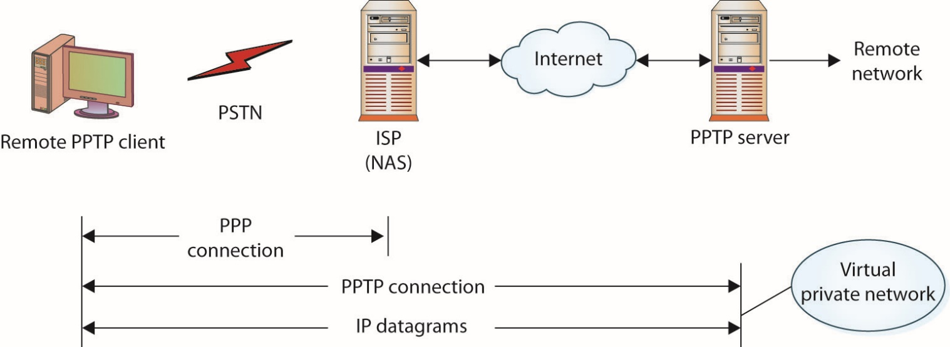
Figure 11.20 PPTP communication diagram
Notes:
For most PPTP implementations, three computers are involved: the PPTP client, the NAS, and a PPTP server, as shown in this figure.

Slide 83
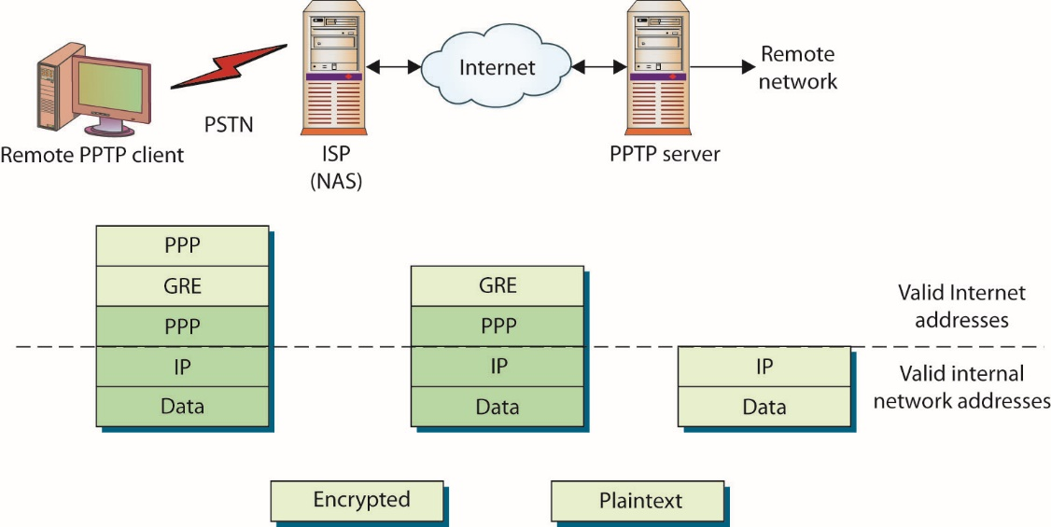
Figure 11.21 PPTP message encapsulation during transmission
Notes:
The connection between the remote client and the network is established in stages, as illustrated in this figure.
First the client makes a PPP connection to a NAS, typically an ISP. (In today’s world of widely available broadband, if there is already an Internet connection, then there is no need to perform the PPP connection to the ISP.) Once the PPP connection is established, a second connection is made over the PPP connection to the PPTP server. This second connection creates the VPN connection between the remote client and the PPTP server. A typical VPN connection is one in which the user is in a hotel with a wireless Internet connection, connecting to a corporate network. This connection acts as a tunnel for future data transfers. Although these diagrams illustrate a telephone connection, this first link can be virtually any method. Common in hotels today are wired connections to the Internet. These wired connections typically are provided by a local ISP and offer the same services as a phone connection, albeit at a much higher data transfer rate.

Slide 84
Authentication Protocols (continued)
Extensible Authentication Protocol (EAP) is a universal authentication framework defined by RFC 3748.
Frequently used in wireless networks and point-to-point connections
Can be used for wired authentication
Most often used in wireless LANs
Notes:
Extensible Authentication Protocol (EAP) is a universal authentication framework defined by RFC 3748 that is frequently used in wireless networks and point-to-point connections. Although EAP is not limited to wireless and can be used for wired authentication, it is most often used in wireless LANs. EAP is discussed in detail in Chapter 12.

Slide 85
Authentication Protocols (continued)
Challenge-Handshake Authentication Protocol (CHAP) is used to provide authentication across a point-to-point link using PPP.
Authentication after the link has been established is not mandatory.
CHAP is designed to provide authentication periodically through the use of a challenge/response system that is sometimes described as a three-way handshake.
Microsoft has created two versions of CHAP.
Notes:
Microsoft has created two versions of CHAP, modified to increase the usability of CHAP across Microsoft’s product line. MSCHAP v1, defined in RFC 2433, has been deprecated and was dropped in Windows Vista. The current standard, version 2, defined in RFC 2759, was introduced with Windows 2000.

Slide 86
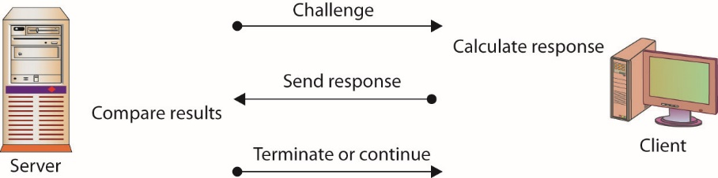
Figure 11.22 The CHAP challenge/response sequence
Notes:
The three-way handshake is illustrated in this figure. The initial challenge (a randomly generated number) is sent to the client. The client uses a one-way hashing function to calculate what the response should be and then sends this back. The server compares the response to what it calculated the response should be. If they match, communication continues. If the two values don’t match, then the connection is terminated. This mechanism relies on a shared secret between the two entities so that the correct values can be calculated.

Slide 87
Authentication Protocols (continued)
NT LAN Manager (NTLM) is an authentication protocol designed by Microsoft for use with the Server Message Block (SMB) protocol.
NTLM v2 is still used when:
Authenticating to a server using an IP address
Authenticating to a server that belongs to a different Active Directory forest
Authenticating to a server that doesn’t belong to a domain
No Active Directory domain exists (“workgroup” or “peer-to-peer” connection)
Notes:
SMB is an application-level network protocol primarily used for sharing of files and printers in Windows-based networks.
NTLM was designed as a replacement for the LANMAN protocol. The current version is NTLM v2, which was introduced with Windows NT 4.0 SP4. Although Microsoft has adopted the Kerberos protocol for authentication, NTLM v2 is still used when:
Authenticating to a server using an IP address
Authenticating to a server that belongs to a different Active Directory forest
Authenticating to a server that doesn’t belong to a domain
No Active Directory domain exists (“workgroup” or “peer-to-peer” connection)

Slide 88
Authentication Protocols (continued)
Password Authentication Protocol (PAP) involves a two-way handshake in which the username and password are sent across the link in cleartext.
PAP authentication does not provide any protection against playback and line sniffing.
PAP is now a deprecated standard.

Slide 89
Authentication Protocols (continued)
Layer 2 Tunneling Protocol (L2TP) is an Internet standard and came from the Layer 2 Forwarding (L2F) protocol, a Cisco initiative designed to address issues with PPTP.
Designed for use across all kinds of networks
Can be implemented by both hardware and software
Designed to work with established AAA services such as RADIUS and TACACS+
Established via UDP port 1701
Notes:
Whereas PPTP is designed around PPP and IP networks, L2F, and hence L2TP, is designed for use across all kinds of networks, including ATM and Frame Relay.
Additionally, whereas PPTP is designed to be implemented in software at the client device, L2TP was conceived as a hardware implementation using a router or a special-purpose appliance. L2TP can be configured in software and is in Microsoft’s RRAS servers, which use L2TP to create a VPN.
L2TP works in much the same way as PPTP, but it opens up several items for expansion. For instance, in L2TP, routers can be enabled to concentrate VPN traffic over higher-bandwidth lines, creating hierarchical networks of VPN traffic that can be more efficiently managed across an enterprise. L2TP also has the ability to use IPsec and Data Encryption Standard (DES) as encryption protocols, providing a higher level of data security. L2TP is also designed to work with established AAA services such as RADIUS and TACACS+ to aid in user authentication, authorization, and accounting.
L2TP is established via UDP port 1701, so this is an essential port to leave open across firewalls supporting L2TP traffic. Microsoft supports L2TP in Windows 2000 and above, but because of the computing power required, most implementations will use specialized hardware (such as a Cisco router).

Slide 90
Authentication Protocols (continued)
Telnet is the standard terminal-emulation protocol within the TCP/IP protocol series.
Allows users to log in remotely and access resources as if the user had a local terminal connection
Offers little security, as usernames, passwords, and all data are passed in cleartext over the TCP/IP connection
Makes its connection using TCP port 23
Important to control access to Telnet on machines and routers when setting them up
Notes:
One of the methods to grant remote access to a system is through Telnet. Telnet is the standard terminal-emulation protocol within the TCP/IP protocol series, and it is defined in RFC 854. Telnet allows users to log in remotely and access resources as if the user had a local terminal connection. Telnet is an old protocol and offers little security. Information, including account names and passwords, is passed in cleartext over the TCP/IP connection.
Telnet makes its connection using TCP port 23. As Telnet is implemented on most products using TCP/IP, it is important to control access to Telnet on machines and routers when setting them up. Failure to control access by using firewalls, access lists, and other security methods, or even by disabling the Telnet daemon, is equivalent to leaving an open door for unauthorized users on a system.

Slide 91
Authentication Protocols (continued)
Secure Shell (SSH) is a protocol series designed to facilitate secure network functions across an insecure network.
Designed to replace the insecure Telnet application
Uses TCP port 22
Three major components
Transport layer protocol
User authentication protocol
Connection protocol
Very popular in the UNIX environment
Notes:
SSH provides direct support for secure remote login, secure file transfer, and secure forwarding of TCP/IP and X Window System traffic. An SSH connection is an encrypted channel, providing for confidentiality and integrity protection.
SSH has its origins as a replacement for the insecure Telnet application from the UNIX operating system. An original component of UNIX, Telnet allowed users to connect between systems. Although Telnet is still used today, it has some drawbacks, as discussed in the preceding section. Some enterprising University of California, Berkeley, students subsequently developed the r- commands, such as rlogin, to permit access based on the user and source system, as opposed to passing passwords. This was not perfect either, however, because when a login was required, it was still passed in the clear. This led to the development of the SSH protocol series, designed to eliminate all of the insecurities associated with Telnet, r- commands, and other means of remote access.
SSH opens a secure transport channel between machines by using an SSH daemon on each end. These daemons initiate contact over TCP port 22 and then communicate over higher ports in a secure mode. One of the strengths of SSH is its support for many different encryption protocols. SSH 1.0 started with RSA algorithms, but at the time they were still under patent, and this led to SSH 2.0 with extended support for Triple DES (3DES) and other encryption methods. Today, SSH can be used with a wide range of encryption protocols, including RSA, 3DES, Blowfish, International Data Encryption Algorithm (IDEA), CAST128, AES256, and others.
The SSH protocol has facilities to encrypt data automatically, provide authentication, and compress data in transit.
It can support strong encryption, cryptographic host authentication, and integrity protection.
The authentication services are host-based and not user-based. If user authentication is desired in a system, it must be set up separately at a higher level in the OSI model.
The SSH protocol has facilities to encrypt data automatically, provide authentication, and compress data in transit. It can support strong encryption, cryptographic host authentication, and integrity protection. The authentication services are host-based and not user-based. If user authentication is desired in a system, it must be set up separately at a higher level in the OSI model. The protocol is designed to be flexible and simple, and it is designed specifically to minimize the number of round-trips between systems. The key exchange, public key, symmetric key, message authentication, and hash algorithms are all negotiated at connection time. Individual data-packet integrity is assured through the use of a message authentication code that is computed from a shared secret, the contents of the packet, and the packet sequence number.
The SSH protocol consists of three major components:
Transport layer protocol Provides server authentication, confidentiality, integrity, and compression
User authentication protocol Authenticates the client to the server
Connection protocol Provides multiplexing of the encrypted tunnel into several logical channels
SSH is very popular in the UNIX environment, and it is actively used as a method of establishing VPNs across public networks. Because all communications between the two machines are encrypted at the OSI application layer by the two SSH daemons, this leads to the ability to build very secure solutions and even solutions that defy the ability of outside services to monitor. As SSH is a standard protocol series with connection parameters established via TCP port 22, different vendors can build differing solutions that can still interoperate.
Exam Tip: SSH uses TCP port 22. SCP (secure copy) and SFTP (secure FTP) use SSH, so each also uses TCP port 22.

Slide 92
FTP/FTPS/SFTP
File Transfer Protocol (FTP) is a plaintext protocol that operates by communicating over TCP between a client and a server.
FTPS is the use of FTP over an SSL/TLS secured channel.
Secure FTP runs FTP over SSH.
Later versions of SSH allow securing of channels such as the FTP control channel.
Leaves the data channel unencrypted – problem solved in version 3.0 of SSH
Notes:
One of the methods of transferring files between machines is through the use of the File Transfer Protocol (FTP). FTP is a plaintext protocol that operates by communicating over TCP between a client and a server. The client initiates a transfer with an FTP request to the server’s TCP port 21. This is the control connection, and this connection remains open over the duration of the file transfer. The actual data transfer occurs on a negotiated data transfer port, typically a high-order port number. FTP was not designed to be a secure method of transferring files. If a secure method is desired, then using FTPS or SFTP is best.
FTPS is the use of FTP over an SSL/TLS secured channel. This can be done either in explicit mode, where an AUTH TLS command is issued, or in implicit mode, where the transfer occurs over TCP port 990 for the control channel and TCP port 989 for the data channel. SFTP is not FTP per se, but rather a completely separate Secure File Transfer Protocol as defined by an IETF Draft, the latest of which, version 6, expired in July 2007, but has been incorporated into products in the marketplace.
It is also possible to run FTP over SSH, as later versions of SSH allow securing of channels such as the FTP control channel; this has also been referred to as Secure FTP. This leaves the data channel unencrypted, a problem that has been solved in version 3.0 of SSH, which supports FTP commands. The challenge of encrypting the FTP data communications is that the mutual port agreement must be opened on the firewall, and for security reasons, high-order ports that are not explicitly defined are typically secured. Because of this challenge, Secure Copy (SCP) is often a more desirable alternative to SFTP when using SSH.

Slide 93
VPNs
A virtual private network (VPN) is a secure virtual network built on top of a physical network.
Virtual private networking is not a protocol per se, but rather a method of using protocols to achieve a specific objective—secure communications.
Typical use of VPN services is a user accessing a corporate data network from a home PC across the Internet.
The sole purpose of the VPN connection is to provide a private connection between the machines.
Notes:
The security of a VPN lies in the encryption of packet contents between the endpoints that define the VPN. The physical network upon which a VPN is built is typically a public network, such as the Internet. Because the packet contents between VPN endpoints are encrypted, to an outside observer on the public network, the communication is secure, and depending on how the VPN is set up, security can even extend to the two communicating parties’ machines.
A typical use of VPN services is a user accessing a corporate data network from a home PC across the Internet. The employee installs VPN software from work on a home PC. This software is already configured to communicate with the corporate network’s VPN endpoint; it knows the location, the protocols that will be used, and so on. When the home user wants to connect to the corporate network, she connects to the Internet and then starts the VPN software. The user can then log into the corporate network by using an appropriate authentication and authorization methodology.
The sole purpose of the VPN connection is to provide a private connection between the machines, which encrypts any data sent between the home user’s PC and the corporate network. Identification, authorization, and all other standard functions are accomplished with the standard mechanisms for the established system.
VPNs can use many different protocols to offer a secure method of communicating between endpoints. Common methods of encryption on VPNs include PPTP, IPsec, SSH, and L2TP, all of which are discussed in this chapter. The key is that both endpoints know the protocol and share a secret. All of this necessary information is established when the VPN is set up. At the time of use, the VPN only acts as a private tunnel between the two points and does not constitute a complete security solution.

Slide 94
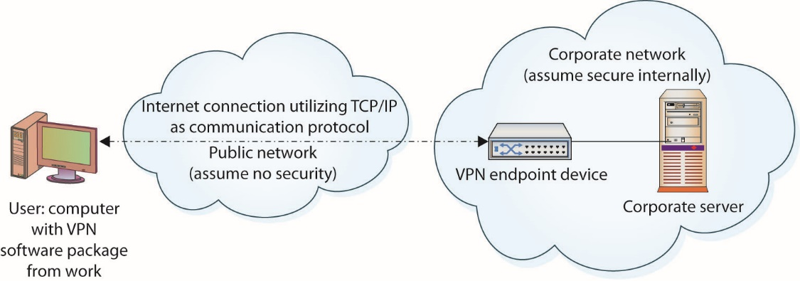
Figure 11.23 VPN service over an Internet connection
Notes:
Virtual private networking is not a protocol per se, but rather a method of using protocols to achieve a specific objective—secure communications—as shown in this figure. A user who wants to have a secure communication channel with a server across a public network can set up two intermediary devices, VPN endpoints, to accomplish this task. The user can communicate with his endpoint, and the server can communicate with its endpoint. The two endpoints then communicate across the public network. VPN endpoints can be software solutions, routers, or specific servers set up for specific functionality. This implies that VPN services are set up in advance and are not something negotiated on-the-fly.

Slide 95
IPsec
Internet Protocol Security (IPsec) is a set of protocols developed by the IETF to securely exchange packets at the network layer (Layer 3) of the OSI model.
IPsec provides a sweeping array of services, such as:
Access control
Connectionless integrity
Traffic-flow confidentiality
Rejection of replayed packets
Data security (encryption)
Notes:
Although these protocols work only in conjunction with IP networks, once an IPsec connection is established, it is possible to tunnel across other networks at lower levels of the OSI model. The set of security services provided by IPsec occurs at the network layer of the OSI model, so higher-layer protocols, such as TCP, UDP, Internet Control Message Protocol (ICMP), Border Gateway Protocol (BGP), and the like, are not functionally altered by the implementation of IPsec services.
The IPsec protocol series has a sweeping array of services it is designed to provide, including but not limited to access control, connectionless integrity, traffic-flow confidentiality, rejection of replayed packets, data security (encryption), and data-origin authentication. IPsec has two defined methods—transport and tunneling—that provide different levels of security. IPsec also has three modes of connection: host-to-server, server-to-server, and host-to-host.
The transport method encrypts only the data portion of a packet, thus enabling an outsider to see source and destination IP addresses. The transport method protects the higher-level protocols associated with a packet and protects the data being transmitted but allows knowledge of the transmission itself. Protection of the data portion of a packet is referred to as content protection.

Slide 96
IPsec (continued)
Protection of the data portion of a packet is referred to as content protection.
Protection of the header information is known as context protection.
A security association (SA) is a formal manner of describing the necessary and sufficient portions of the IPsec protocol series to achieve a specific level of protection.
They exist both for integrity protecting systems and confidentiality-protecting systems.
Notes:
The transport method encrypts only the data portion of a packet, thus enabling an outsider to see source and destination IP addresses. The transport method protects the higher-level protocols associated with a packet and protects the data being transmitted but allows knowledge of the transmission itself. Protection of the data portion of a packet is referred to as content protection.
Tunneling provides encryption of source and destination IP addresses, as well as of the data itself. This provides the greatest security, but it can be done only between IPsec servers (or routers) because the final destination needs to be known for delivery. Protection of the header information is known as context protection.
It is possible to use both methods at the same time, such as using transport within one’s own network to reach an IPsec server, which then tunnels to the target server’s network, connecting to an IPsec server there, and then using the transport method from the target network’s IPsec server to the target host.
A security association (SA) is a formal manner of describing the necessary and sufficient portions of the IPsec protocol series to achieve a specific level of protection. Because many options exist, both communicating parties must agree on the use of the protocols that are available, and this agreement is referred to as a security association. SAs exist both for integrity protecting systems and confidentiality-protecting systems. In each IPsec implementation, a security association database (SAD) defines parameters associated with each SA. The SA is a one-way (simplex) association, and if two-way communication security is desired, two SAs are used—one for each direction.
Exam Tip: In transport mode (end-to-end), security of packet traffic is provided by the endpoint computers. In tunnel mode (portal-to-portal), security of packet traffic is provided between endpoint node machines in each network and not at the terminal host machines.

Slide 97
IPsec (continued)
IPsec configurations
Four basic configurations can be applied to machine-to-machine connections.
Host-to-host connection, wherein the Internet is not part of the SA between the machines
Two security devices in the stream securing the network between them
A combination of the first two configurations
User establishes an SA with the security gateway and then a separate SA with the desired server
Notes:
Four basic configurations can be applied to machine-to-machine connections using IPsec.
The simplest IPsec configuration is a host-to-host connection between two machines. In this case, the Internet is not a part of the SA between the machines.
If bidirectional security is desired, two SAs are used. The SAs are effective from host to host.
The second case places two security devices in the stream, relieving the hosts of the calculation and encapsulation duties. These two gateways have an SA between them. The network is assumed to be secure from each machine to its gateway, and no IPsec is performed across these hops. The two security gateways with a tunnel across the Internet, although either tunnel or transport mode could be used.
The third case combines the first two. A separate SA exists between the gateway devices, but an SA also exists between hosts. This could be considered a tunnel inside a tunnel.
Remote users commonly connect through the Internet to an organization’s network. The network has a security gateway through which it secures traffic to and from its servers and authorized users. In the last case, the user establishes an SA with the security gateway and then a separate SA with the desired server, if required.
This can be done using software on a remote laptop and hardware at the organization’s network.
Windows can act as an IPsec server, as can routers and other servers. The primary issue is CPU usage and where the computing power should be implanted. This consideration has led to the rise of IPsec appliances, which are hardware devices that perform the IPsec function specifically for a series of communications. Depending on the number of connections, network bandwidth, and so on, these devices can be inexpensive for small office or home office use or quite expensive for large, enterprise-level implementations.

Slide 98
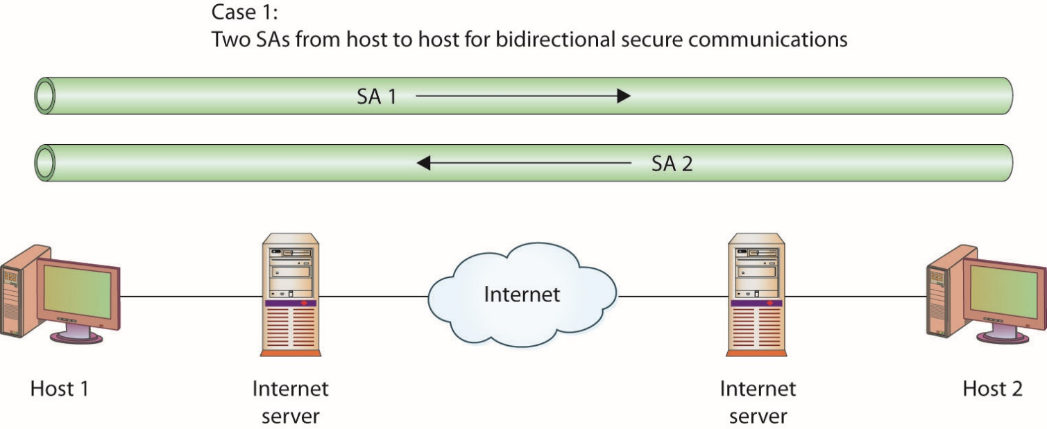
Figure 11.24 A host-to-host connection between two machines
Notes:
The simplest IPsec configuration is a host-to-host connection between two machines. In this case, the Internet is not a part of the SA between the machines.
If bidirectional security is desired, two SAs are used. The SAs are effective from host to host.

Slide 99
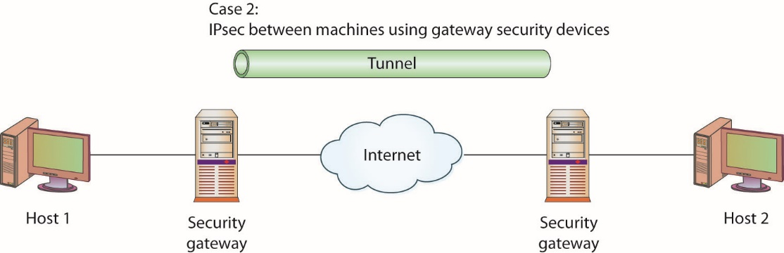
Figure 11.25 Two security gateways with a tunnel across the Internet
Notes:
The second case places two security devices in the stream, relieving the hosts of the calculation and encapsulation duties. These two gateways have an SA between them. The network is assumed to be secure from each machine to its gateway, and no IPsec is performed across these hops. The two security gateways with a tunnel across the Internet, although either tunnel or transport mode could be used.

Slide 100
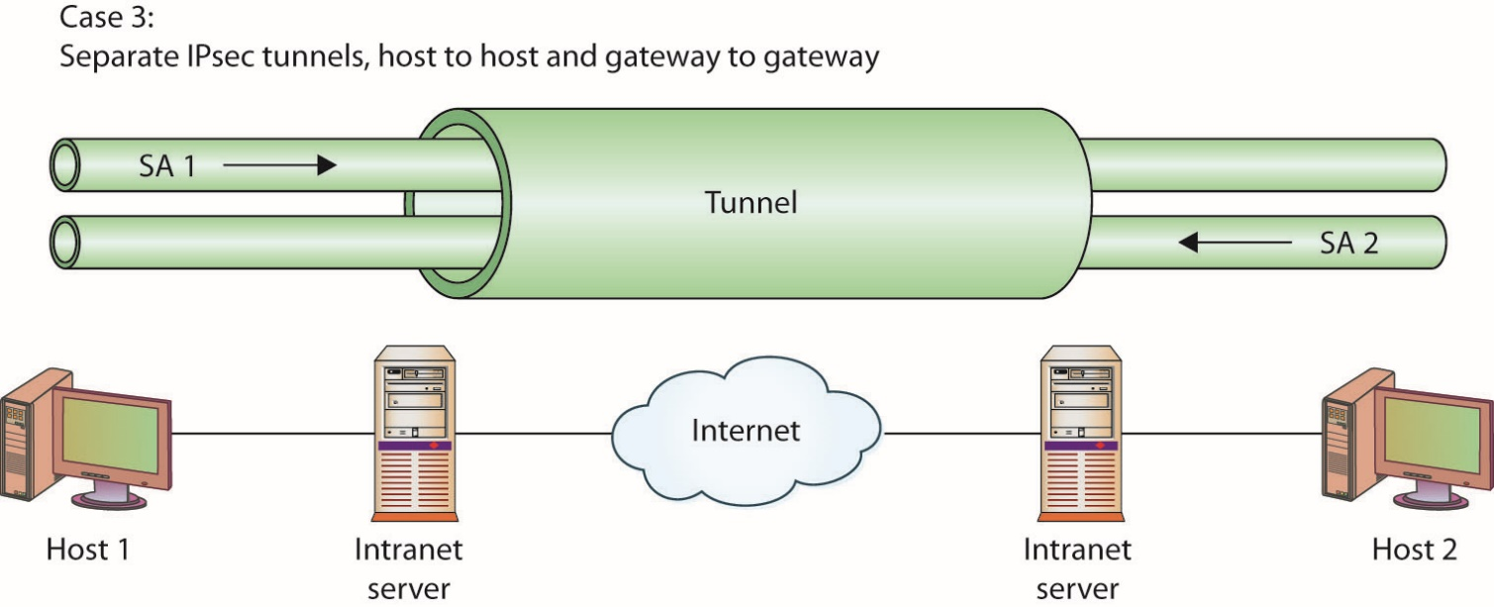
Figure 11.26 A tunnel inside a tunnel
Notes:
The third case combines the first two. A separate SA exists between the gateway devices, but an SA also exists between hosts. This could be considered a tunnel inside a tunnel.

Slide 101
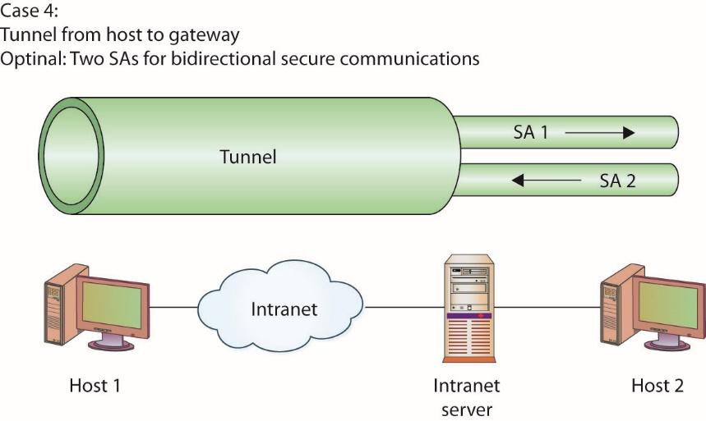
Figure 11.27 Tunnel from host to gateway
Notes:
Remote users commonly connect through the Internet to an organization’s network. The network has a security gateway through which it secures traffic to and from its servers and authorized users. In the last case, the user establishes an SA with the security gateway and then a separate SA with the desired server, if required. This can be done using software on a remote laptop and hardware at the organization’s network.

Slide 102
IPsec (continued)
IPsec uses two protocols to provide traffic security:
Authentication Header (AH) – a header added to a packet for the purposes of integrity checking
Encapsulating Security Payload (ESP) – encrypting the data portion of a datagram to provide confidentiality
Protocols for key management and exchange include:
Internet Security Association and Key Management Protocol (ISAKMP)
Oakley
Secure Key Exchange Mechanism for Internet (SKEMI)
Notes:
These key management protocols can be collectively referred to as Internet Key Management Protocol (IKMP) or Internet Key Exchange (IKE).
IPsec does not define specific security algorithms, nor does it require specific methods of implementation. IPsec is an open framework that allows vendors to implement existing industry-standard algorithms suited for specific tasks. This flexibility is key in IPsec’s ability to offer a wide range of security functions. IPsec allows several security technologies to be combined into a comprehensive solution for network-based confidentiality, integrity, and authentication.
IPsec uses the following:
Diffie-Hellman key exchange between peers on a public network
Public key signing of Diffie-Hellman key exchanges to guarantee identity and avoid man-in-the-middle attacks
Bulk encryption algorithms, such as IDEA and 3DES, for encrypting data
Keyed hash algorithms, such as HMAC, and traditional hash algorithms, such as MD5 and SHA-1, for packet-level authentication
Digital certificates to act as digital ID cards between parties

Slide 103
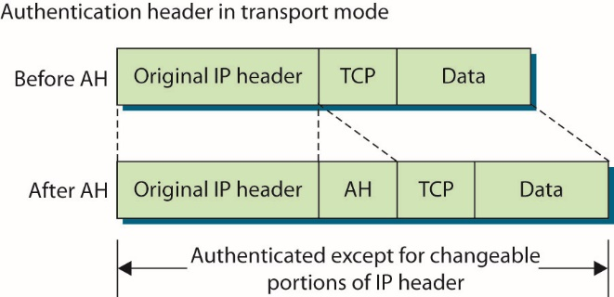
Figure 11.28 IPsec use of AH in transport mode
Notes:
To provide traffic security, two header extensions have been defined for IP datagrams. The AH, when added to an IP datagram, ensures the integrity of the data and also the authenticity of the data’s origin. By protecting the nonchanging elements in the IP header, the AH protects the IP address, which enables data-origin authentication. The ESP provides security services for the higher-level protocol portion of the packet only, not the IP header.
AH and ESP can be used separately or in combination, depending on the level and types of security desired. Both also work with the transport and tunnel modes of IPsec protocols. In transport mode, the two communication endpoints provide security primarily for the upper-layer protocols. The cryptographic endpoints, where encryption and decryption occur, are located at the source and destination of the communication channel. When AH is in transport mode, the original IP header is exposed, but its contents are protected via the AH block in the packet, as illustrated in this figure.

Slide 104
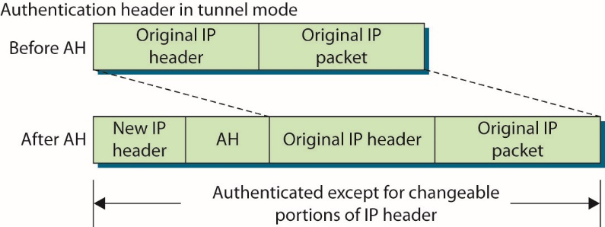
Figure 11.29 IPsec use of AH in tunnel mode
Notes:
When AH is employed in tunnel mode, portions of the outer IP header are given the same header protection that occurs in transport mode, with the entire inner packet receiving protection. This is illustrated in this figure.

Slide 105
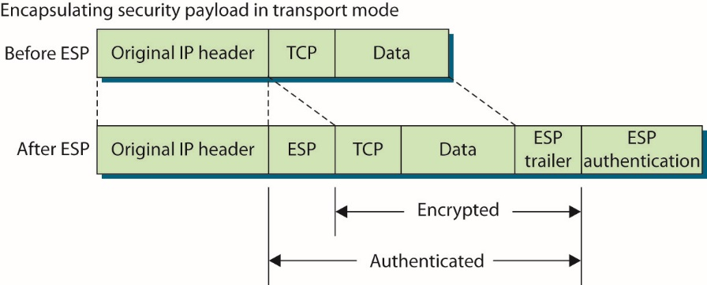
Figure 11.30 IPsec use of ESP in transport mode
Notes:
ESP provides a means of encrypting the packet’s contents, as shown in Figure 11.30. In this case, in transport mode, the datagram contents are encrypted and authenticated via the ESP header and footer/trailer that are inserted into the datagram.

Slide 106
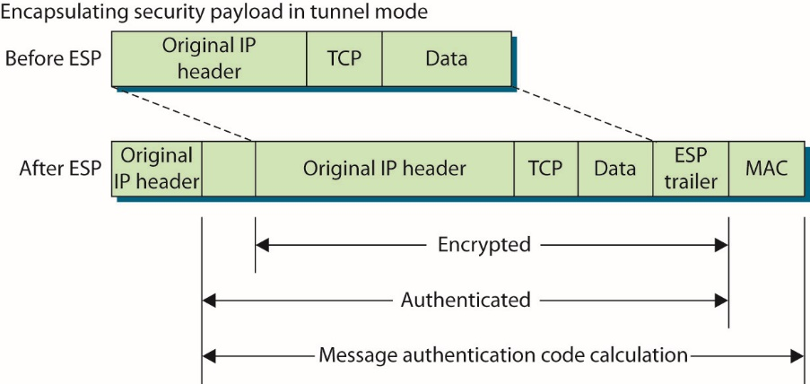
Figure 11.31 IPsec use of ESP in tunnel mode
Notes:
As mentioned, AH and ESP can be employed in tunnel mode. ESP affords the same encryption protection to the contents of the tunneled packet, which is the entire packet from the initial sender, as illustrated in Figure 11.31.

Slide 107
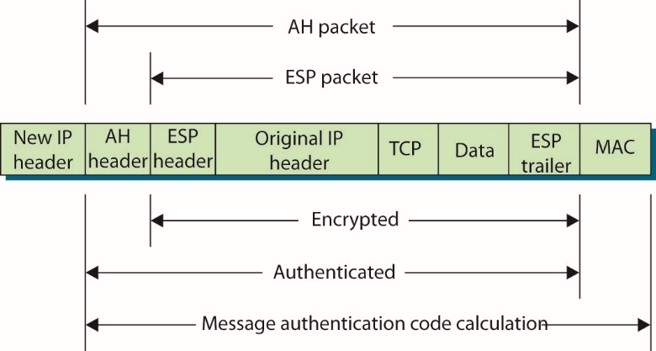
Figure 11.32 IPsec ESP and AH packet construction in tunnel mode
Notes:
Together, in tunnel mode, AH and ESP can provide complete protection across the packet, as shown in Figure 11.32. The specific combination of AH and ESP is referred to as a security association in IPsec.

Slide 108
IPsec (continued)
In IP version 4 (IPv4), IPsec is an add-on, and its acceptance is vendor driven.
In IPv6, IPsec is integrated into IP and is native on all packets.
Its use is still optional, but its inclusion in the protocol suite will guarantee interoperability across vendor solutions when they are compliant with IPv6 standards.
IPsec uses cryptographic keys in its security process.
The default method of key management, Internet Key Exchange (IKE), is automated.
Notes:
In IP version 4 (IPv4), IPsec is an add-on, and its acceptance is vendor driven. It is not a part of the original IP—one of the short-sighted design flaws of the original IP. In IPv6, IPsec is integrated into IP and is native on all packets. Its use is still optional, but its inclusion in the protocol suite will guarantee interoperability across vendor solutions when they are compliant with IPv6 standards.
IPsec uses cryptographic keys in its security process and has both manual and automatic distribution of keys as part of the protocol series. Manual key distribution is included, but it is practical only in small, static environments and does not scale to enterprise-level implementations. The default method of key management, Internet Key Exchange (IKE), is automated. IKE authenticates each peer involved in IPsec and negotiates the security policy, including the exchange of session keys. IKE creates a secure tunnel between peers and then negotiates the security association for IPsec across this channel. This is done in two phases: the first develops the channel, and the second develops the security association.

Slide 109
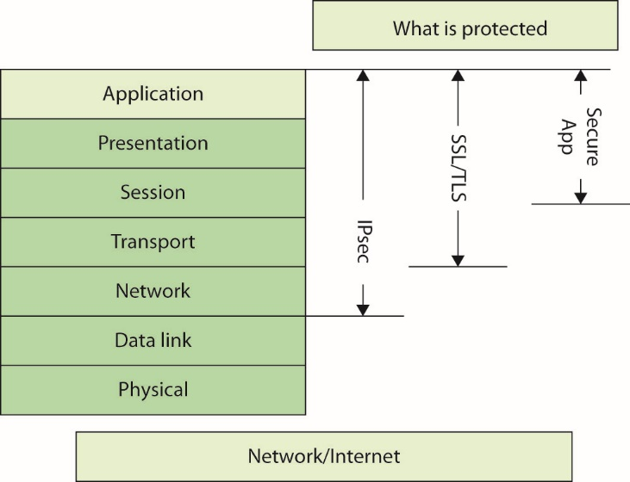
Figure 11.33 Protection from different levels of encryption
Notes:
Figure 11.33 illustrates the different levels of protection offered by VPNs and IPsec. This shows the advantages of IPsec and its more comprehensive coverage.

Slide 110
Vulnerabilities of Remote Access Methods
The primary vulnerability associated with many of these methods of remote access is the passing of critical data in cleartext.
The strength of the encryption algorithm is also a concern.
There always exists the possibility that a bug could open the system to attack.
Notes:
The primary vulnerability associated with many of these methods of remote access is the passing of critical data in cleartext. Plaintext passing of passwords provides no security if the password is sniffed, and sniffers are easy to use on a network. Even plaintext passing of user IDs gives away information that can be correlated and possibly used by an attacker. Plaintext credential passing is one of the fundamental flaws with Telnet and is why SSH was developed. This is also one of the flaws with RADIUS and TACACS+, as they have a segment unprotected. There are methods for overcoming these limitations, although they require discipline and understanding in setting up a system.
The strength of the encryption algorithm is also a concern. Should a specific algorithm or method prove to be vulnerable, services that rely solely on it are also vulnerable. To get around this dependency, many of the protocols allow numerous encryption methods, so that should one prove vulnerable, a shift to another restores security.
As with any software implementation, there always exists the possibility that a bug could open the system to attack. Bugs have been corrected in most software packages to close holes that made systems vulnerable, and remote access functionality is no exception. This is not a Microsoft-only phenomenon, as one might believe from the popular press. Critical flaws have been found in almost every product, from open system implementations such as OpenSSH to proprietary systems such as Cisco IOS. The important issue is not the presence of software bugs, for as software continues to become more complex, this is an unavoidable issue. The true key is vendor responsiveness to fixing the bugs once they are discovered, and the major players, such as Cisco and Microsoft, have been very responsive in this area.

Slide 111
Module 6 Authentication and Remote Access and Intrusion Detection Systems and Network Security – Part 3

Slide 112
Key Terms
Analysis engine
Anomaly detection model
Banner grabbing
Content-based signature
Context-based signature
Digital sandbox
False negative
False positive
Honeynet
Honeypot
Host-based IDS (HIDS)
Intrusion detection system (IDS)
Notes:
Analysis engine – Examines the collected network traffic and compares it to known patterns of suspicious or malicious activity stored in the signature database. The analysis engine is the “brains” of the IDS.
Anomaly detection model – An IDS model where the IDS must know what “normal” behavior on the host or network being protected really is. Once the “normal” behavior baseline is established, the IDS can then go to work identifying deviations from the norm, which are further scrutinized to determine whether or not that activity is malicious.
Banner grabbing – A technique used to gather information from a service that publicizes information via a banner.
Content-based signature – Signatures that are designed to examine the content of such things as network packets or log entries. Content-based signatures are typically easy to build and look for simple things, such as a certain string of characters or a certain flag set in a TCP packet.
Context-based signature – Signatures that are designed to match large patterns of activity and examine how certain types of activity fit into the other activities going on around them. Context signatures generally address the question: How does this event compare to other events that have already happened or might happen in the near future? Context-based signatures are more difficult to analyze and take more resources to match, as the IDS must be able to “remember” past events to match certain context signatures.
Digital sandbox – The isolation of a program and its supporting elements from common operating system functions.
False negative – Term used when a system makes an error and misses reporting the existence of an item that should have been detected.
False positive – Term used when a security system makes an error and incorrectly reports the existence of a searched-for object. Examples include an intrusion detection system that misidentifies benign traffic as hostile, an antivirus program that reports the existence of a virus in software that actually is not infected, or a biometric system that allows access to a system to an unauthorized individual.
Honeynet – A network version of a honeypot, or a set of honeypots networked together.
Honeypot – A computer system or portion of a network that has been set up to attract potential intruders, in the hope that they will leave the other systems alone. Since there are no legitimate users of this system, any attempt to access it is an indication of unauthorized activity and provides an easy mechanism to spot attacks.
Host-based IDS (HIDS) – A system that looks for computer intrusions by monitoring activity on one or more individual PCs or servers.
Intrusion detection system (IDS) – A system to identify suspicious, malicious, or undesirable activity that indicates a breach in computer security.

Slide 113
Key Terms (continued)
Intrusion prevention system (IPS)
Misuse detection model
Network tap
Network-based IDS (NIDS)
Perimeter security
Port mirroring
Protocol analyzer
Signature database
Snort
Suricata
Switched Port Analyzer (SPAN)
Traffic collector
User interface and reporting
Notes:
Intrusion prevention system (IPS) – A system to identify suspicious, malicious, or undesirable activity that indicates a breach in computer security and respond automatically without specific human interaction.
Misuse detection model – An IDS model where the IDS looks for suspicious activity or activity that violates specific policies and then reacts as it has been programmed to do. This reaction can be an alarm, e-mail, router reconfiguration, or TCP reset message. Network tap – A connection to a network that allows sampling, duplication, and collection of traffic. Network-based IDS (NIDS) – A system for examining network traffic to identify suspicious, malicious, or undesirable behavior.
Perimeter security – A technique where more and more companies operate their computer security like a castle or military base, with attention and effort focused on securing and controlling the ways in and out—the idea being that if you could restrict and control access at the perimeter, you didn’t have to worry as much about activity inside the organization. Port mirroring – A technique where a mirrored port will see all the traffic passing through the switch or through a specific VLAN(s), or all the traffic passing through other specific switch ports. The network traffic is essentially copied (or mirrored) to a specific port, which can then support a protocol analyzer.
Protocol analyzer – A tool used by network personnel to identify packets and header information during network transit. The primary use is in troubleshooting network communication issues.
Signature database – A collection of activity patterns that have already been identified and categorized and that typically indicate suspicious or malicious activity.
Snort – The de facto standard IDS engine since its creation in 1998. It has a large user base and set the standard for many IDS element, including rule sets and formats. Snort rules are the list of activities that Snort will alert on and provide the flexible power behind the IDS platform. Snort rule sets are updated by a large active community as well as Sourcefire Vulnerability Research Team, the company behind Snort. Snort VRT rule sets are available to subscribers and provide such elements as same-day protection for items such as Microsoft patch Tuesday vulnerabilities. These rules are moved to the open community after 30 days.
Suricata – An open source IDS, begun with grant money from the U.S. government and maintained by the Open Source Security Foundation (OSIF). Suricata has one advantage over Snort: it supports multithreading.
Switched Port Analyzer (SPAN) – A technology employed that can duplicate individual channels crossing a switch to another circuit.
Traffic collector – Collects activity/events for the IDS to examine. On a HIDS, this could be log files, audit logs, or traffic coming to or leaving a specific system. On a NIDS, this is typically a mechanism for copying traffic off the network link—basically functioning as a sniffer. This component is often referred to as a sensor.
User interface and reporting – Interfaces with the human element, providing alerts when appropriate and giving the user a means to interact with and operate the IDS.

Slide 114
Introduction
An intrusion detection system (IDS) is a security system that detects inappropriate or malicious activity on a computer or network.
The foundation for a layered network security approach usually starts with a well-secured system.
Some of the more complicated and interesting types of network/data security devices are IDSs.
Notes:
Most organizations use their own approaches to network security, choosing the layers that make sense for them after they weigh risks, potentials for loss, costs, and manpower requirements. The foundation for a layered network security approach usually starts with a well-secured system, regardless of the system’s function (whether it’s a user PC or a corporate e-mail server).
A well-secured system uses up-to-date application and operating system patches, requires well-chosen passwords, runs the minimum number of services necessary, and restricts access to available services. On top of that foundation, you can add layers of protective measures such as antivirus products, firewalls, sniffers, and IDSs.
The main purpose of an IDS is to identify suspicious or malicious activity, note activity that deviates from normal behavior, catalog and classify the activity, and, if possible, respond to the activity.

Slide 115
History of Intrusion Detection Systems
The IDS concept came from U.S. Department of Defense–sponsored research.
Early 1970s: U.S. government and military became increasingly aware of the need to protect the electronic networks that were becoming critical to daily operations.
Continued research led to projects such as Discovery, Haystack, Multics Intrusion Detection and Alerting System (MIDAS), and Network Audit Director and Intrusion Reporter (NADIR).

Slide 116
History of Intrusion Detection Systems (continued)
1989: Haystack Labs released Stalker
Stalker was the first commercial IDS.
In the early to mid-1990s, computer systems grew.
Companies started to realize the importance of IDSs.
IDS solutions were host-based and required a great deal of time and money to manage and operate effectively.
Focus began to shift away from host-based systems, and network-based IDSs began to emerge.
Notes:
Stalker was host-based and worked by comparing audit data to known patterns of suspicious activity. While the military and government embraced the concept, the commercial world was very slow to adopt IDS products, and it was several years before other commercial products began to emerge.
NetRanger was designed to monitor network links and the traffic moving across the links to identify misuse as well as suspicious and malicious activity.

Slide 117
History of Intrusion Detection Systems (continued)
1995: WheelGroup developed NetRanger.
NetRanger was the first commercial network-based IDS product.
1996: Internet Security Systems released RealSecure.
February 1998: Cisco Systems acquired WheelGroup.
IDSs were recognized as a vital part of any network security infrastructure.

Slide 118
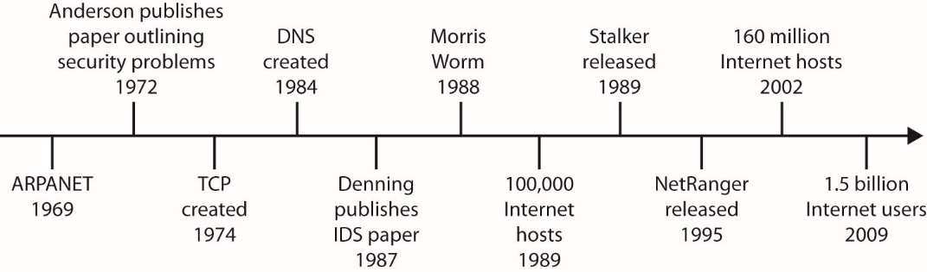
Figure 13.1 History of the Internet and IDS

Slide 119
IDS Overview
IDSs are typically divided into two main categories depending on how they monitor activity.
Host-based IDS (HIDS)
Examines activity on an individual system.
Concerned with an individual system.
Network-based IDS (NIDS)
NIDS examines activity on the network itself.
It has visibility only into the traffic crossing the network link it is monitoring and typically has no idea of what is happening on individual systems.

Slide 120
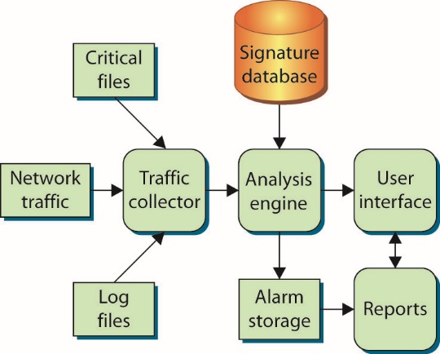
Figure 13.2 Logical depiction of IDS components
Notes:
Whether it is network- or host-based, an IDS typically consists of several specialized components working together, as illustrated in this figure. These components are often logical and software-based rather than physical and will vary slightly from vendor to vendor and product to product.

Slide 121
IDS Overview (continued)
An IDS has the following logical components:
Traffic collector (or sensor) – collects activity/events for the IDS to examine.
Analysis engine – examines the collected network traffic and compares it to known patterns of suspicious or malicious activity
Signature database – a collection of patterns and definitions of known suspicious or malicious activity
User interface and reporting – interfaces with the human element and provide alerts when appropriate
Notes:
Typically, an IDS has the following logical components:
Traffic collector (or sensor) Collects activity/events for the IDS to examine. On a HIDS, this could be log files, audit logs, or traffic coming to or leaving a specific system. On a NIDS, this is typically a mechanism for copying traffic off the network link—basically functioning as a sniffer. This component is often referred to as a sensor.
Analysis engine Examines the collected network traffic and compares it to known patterns of suspicious or malicious activity stored in the signature database. The analysis engine is the “brains” of the IDS.
Signature database A collection of patterns and definitions of known suspicious or malicious activity.
User interface and reporting Interfaces with the human element, providing alerts when appropriate and giving the user a means to interact with and operate the IDS.
In addition to the network versus host distinction, some IDS vendors will further categorize an IDS based on how it performs the detection of suspicious or malicious traffic.

Slide 122
IDS Models
IDSs are classified by the detection model used: anomaly or misuse.
Anomaly detection model is the more complicated of the two.
Identifies “normal” behavior on protected host or network
IDS identifies deviations from the norm; IDS further scrutinizes to determine if malicious activity
Building profile of normal activity done by the IDS
Allows system to deal with variations in traffic
Not restricted to a specific signature set
Notes:
An anomaly detection model is the more complicated of the two. In this model, the IDS must know what “normal” behavior on the host or network being protected really is. Once the “normal” behavior baseline is established, the IDS can then go to work identifying deviations from the norm, which are further scrutinized to determine whether or not that activity is malicious. Building the profile of normal activity is usually done by the IDS, with some input from security administrators, and can take days to months. The IDS must be flexible and capable enough to account for things such as new systems, new users, movement of information resources, and other factors, but be sensitive enough to detect a single user illegally switching from one account to another at 3 A.M. on a Saturday.
Anomaly detection was developed to make the system capable of dealing with variations in traffic and better able to determine which activity patterns were malicious.
A perfectly functioning anomaly-based system would be able to ignore patterns from legitimate hosts and users but still identify those patterns as suspicious should they come from a potential attacker. Unfortunately, most anomaly-based systems suffer from extremely high false positives, especially during the “break-in” period while the IDS is learning the network. On the other hand, an anomaly-based system is not restricted to a specific signature set and is far more likely to identify a new exploit or attack tool that would go unnoticed by a traditional IDS.

Slide 123
IDS Models (continued)
Misuse detection model is simpler to implement and the more popular model.
Looks for suspicious activity or activity that violates specific policies and then reacts as it has been programmed to do
Reactions – alarm, e-mail, router reconfiguration, or TCP reset message
More efficient model
Relies on a predefined signature base – drawback of model
Easier and cheaper to implement
Notes:
A misuse detection model is a little simpler to implement, and therefore it’s the more popular of the two models. In a misuse detection model, the IDS looks for suspicious activity or activity that violates specific policies and then reacts as it has been programmed to do. This reaction can be an alarm, e-mail, router reconfiguration, or TCP reset message. Technically, misuse detection is the more efficient model, as it takes fewer resources to operate, does not need to learn what “normal” behavior is, and will generate an alarm whenever a pattern is successfully matched.
However, the misuse model’s greatest weakness is its reliance on a predefined signature base—any activity, malicious or otherwise, that the misuse-based IDS does not have a signature for will go undetected.
Despite that drawback and because it is easier and cheaper to implement, most commercial IDS products are based on the misuse detection model.

Slide 124
IDS Models (continued)
There are four categories describing how the IDS operates and detects malicious traffic:
Behavior based relies on a collected set of “normal behavior.”
Signature–based relies on a predefined set of patterns (called signatures).
Anomaly-based is essentially the same as behavior-based.
Heuristic uses artificial intelligence to detect intrusions and malicious traffic.
Notes:
Some analysts break IDS models down even further into four categories depending on how the IDS operates and detects malicious traffic (the same models can also be applied to intrusion prevention systems as well—both NIPS and HIPS):
Behavior-based This model relies on a collected set of “normal behavior”: what should happen on the network and is considered “normal” or “acceptable” traffic. Behavior that does not fit into the “normal” activity categories or patterns is considered suspicious or malicious. This model can potentially detect zero-day or unpublished attacks but carries a high false positive rate as any new traffic pattern can be labeled as “suspect.”
Signature-based This model relies on a predefined set of patterns (called signatures). The IDS has to know what behavior is considered “bad” ahead of time before it can identify and act upon suspicious or malicious traffic.
Anomaly-based This model is essentially the same as behavior-based. The IDS is first taught what “normal” traffic looks like and then looks for deviations to those “normal” patterns.
Heuristic This model uses artificial intelligence to detect intrusions and malicious traffic. A heuristic model is typically implemented through algorithms that help an IDS decide if a traffic pattern is malicious or not. For example, a URL containing 10 or more of the same repeating character may be considered “bad” traffic as a single signature. With a heuristic model, the IDS understands that if 10 repeating characters are bad, 11 are still bad, and 20 are even worse. This implementation of fuzzy logic allows this model to fall somewhere between signature-based and behavior-based models.

Slide 125
Signatures
One of the critical elements of any good IDS is the signature database.
The set of patterns the IDS uses to determine whether or not activity is potentially hostile
Signatures can be very simple or remarkably complicated, depending on the activity they are trying to highlight.
Signatures can be divided into two main groups, depending on what the signature is looking for.
Content-based and context-based

Slide 126
Signatures (continued)
Content-based signatures
Generally simple
Examine content network packets or log entries
Easy to build and look for simple things, such as a certain string of characters or a certain flag set in a TCP Packet
Context-based signatures
Generally complicated
Designed to match large patterns of activity and examine how certain types of activity fit into the other activities going on around them
Notes:
Exam Tip: Know the differences between content-based and context-based signatures. Content-based signatures match specific content, such as a certain string or series of characters (matching the string /etc/passwd in an FTP session). Context-based signatures match a pattern of activity based on the other activity around it, such as a port scan.
Content-based signatures are generally the simplest. They are designed to examine the content of such things as network packets or log entries. Content-based signatures are typically easy to build and look for simple things, such as a certain string of characters or a certain flag set in a TCP packet.
Here are some example content-based signatures:
Matching the characters /etc/passwd in a Telnet session. On a UNIX system, the names of valid user accounts (and sometimes the passwords for those user accounts) are stored in a file called passwd located in the etc directory.
Matching the characters “to: decode” in the header of an e-mail message. On certain older versions of sendmail, sending an e-mail message to “decode” would cause the system to execute the contents of the e-mail
Context-based signatures are generally more complicated, as they are designed to match large patterns of activity and examine how certain types of activity fit into the other activities going on around them. Context signatures generally address the question: How does this event compare to other events that have already happened or might happen in the near future? Context-based signatures are more difficult to analyze and take more resources to match, as the IDS must be able to “remember” past events to match certain context signatures. Here are some example context-based signatures:
Match a potential intruder scanning for open web servers on a specific network. A potential intruder may use a port scanner to look for any systems accepting connections on port 80. To match this signature, the IDS must analyze all attempted connections to port 80 and then be able to determine which connection attempts are coming from the same source but are going to multiple, different destinations.
Identify a Nessus scan. Nessus is an open-source vulnerability scanner that allows security administrators (and potential attackers) to quickly examine systems for vulnerabilities. Depending on the tests chosen, Nessus typically performs the tests in a certain order, one after the other. To be able to determine the presence of a Nessus scan, the IDS must know which tests Nessus runs as well as the typical order in which the tests are run.
Identify a ping flood attack. A single ICMP packet on its own is generally regarded as harmless, certainly not worthy of an IDS signature. Yet thousands of ICMP packets coming to a single system in a short period of time can have a devastating effect on the receiving system. By flooding a system with thousands of valid ICMP packets, an attacker can keep a target system so busy it doesn’t have time to do anything else—a very effective denial-of-service attack. To identify a ping flood, the IDS must recognize each ICMP packet and keep track of how many ICMP packets different systems have received in the recent past.
To function, the IDS must have a decent signature base with examples of known, undesirable activity that it can use when analyzing traffic or events. Any time an IDS matches current events against a signature, the IDS could be considered successful, as it has correctly matched the current event against a known signature and reacted accordingly (usually with an alarm or alert of some type).

Slide 127
False Positives and False Negatives
When an IDS matches a pattern and generates an alarm for benign traffic, meaning the traffic was not hostile and not a threat, this is called a false positive.
The IDS matches a pattern and raises an alarm when it does not really need to do so.
Hostile activity that does not match an IDS signature and therefore goes undetected is called a false negative.
In this case, the IDS is not generating any alarms, even though it should be; this gives a false sense of security.
Notes:
Viewed in its simplest form, an IDS is really just looking at activity (be it host-based or network-based) and matching it against a predefined set of patterns. When it matches activity to a specific pattern, the IDS cannot know the true intent behind that activity—whether it is benign or hostile—and therefore it can react only as it has been programmed to do. In most cases, this means generating an alert that must then be analyzed by a human who tries to determine the intent of the traffic from whatever information is available.
Keep in mind that the IDS can only match patterns and has no ability to determine intent behind the activity, so in some ways this is an unfair label. Technically, the IDS is functioning correctly by matching the pattern, but from a human standpoint this is not information the analyst needed to see, as it does not constitute a threat and does not require intervention.
An IDS is also limited by its signature set—it can match only activity for which it has stored patterns.

Slide 128
Network-Based IDSs
Network-based IDSs (NIDSs) came along a few years after host-based systems.
NIDS integrated very well into the concept of perimeter security.
Computer security attention and effort focused on securing and controlling the ways in and out.
Idea was that you could restrict and control access at the perimeter, you did not have to worry as much about activity inside the organization.
However, many incidents originate inside the perimeter.
Notes:
Network-based IDSs (NIDSs) actually came along a few years after host-based systems. After running host-based systems for a while, many organizations grew tired of the time, energy, and expense involved with managing the first generation of these systems—the host-based systems were not centrally managed, there was no easy way to correlate alerts between systems, and false-positive rates were high. The desire for a “better way” grew along with the amount of interconnectivity between systems and, consequently, the amount of malicious activity coming across the networks themselves. This fueled development of a new breed of IDS designed to focus on the source for a great deal of the malicious traffic—the network itself.
Even though the idea of a security perimeter is somewhat flawed (many security incidents originate inside the perimeter), it caught on very quickly, as it was easy to understand and devices such as firewalls, bastion hosts, and routers were available to define and secure that perimeter. The best way to secure the perimeter from outside attack is to reject all traffic from external entities, but this is impossible and impractical to do, so security personnel needed a way to let traffic in but still be able to determine whether or not the traffic was malicious. This is the problem that NIDS developers were trying to solve.

Slide 129

Figure 13.3 Network perimeters are a little like castles—firewalls and NIDSs form the gates and guards to keep malicious traffic out.
Notes:
More and more companies began to operate their computer security like a castle or military base.

Slide 130
Network-Based IDSs (continued)
NIDS focuses on network traffic.
A NIDS must examine the network traffic as it passes by and be able to analyze traffic according to protocol, type, amount, source, destination, content, traffic already seen, and other factors.
This analysis must happen quickly, and the NIDS must be able to handle traffic at whatever speed the network operates to be effective.
NIDSs are typically deployed so that they can monitor traffic in and out of an organization’s major links.

Slide 131
Network-Based IDSs (continued)
NIDSs look for certain activities that typify hostile actions or misuse, such as the following:
Denial-of-service attacks
Port scans or sweeps
Malicious content in the data payload of a packet or packets
Vulnerability scanning
Trojans, viruses, or worms
Tunneling
Brute-force attacks
Notes:
NIDSs look for certain activities that typify hostile actions or misuse, such as the following:
Denial-of-service attacks
Port scans or sweeps
Malicious content in the data payload of a packet or packets
Vulnerability scanning
Trojans, viruses, or worms
Tunneling
Brute-force attacks

Slide 132
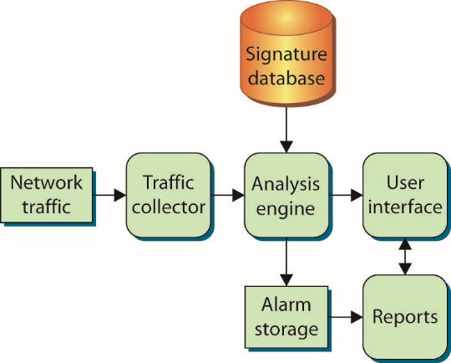
Figure 13.4 Network IDS components
Notes:
In general, most NIDSs operate in a fairly similar fashion. This figure shows the logical layout of a NIDS. By considering the function and activity of each component, you can gain some insight into how a NIDS operates.

Slide 133
Network-Based IDSs (continued)
NIDs major components include:
Traffic collector
Analysis engine
Reports
User interface
The NIDS signature database is usually much larger than that of a host-based system.
Using lessons learned from HIDS, NIDS developers modified the logical component design to distribute the user interface and reporting functions.
Notes:
In a NIDS, the traffic collector is specifically designed to pull traffic from the network. This component usually behaves in much the same way as a network traffic sniffer—it simply pulls every packet it can see off the network to which it is connected. In a NIDS, the traffic collector will logically attach itself to a network interface card (NIC) and instruct the NIC to accept every packet it can. A NIC that accepts and processes every packet regardless of the packet’s origin and destination is said to be in promiscuous mode.
The analysis engine in a NIDS serves the same function as its host-based counterpart, with some substantial differences. The network analysis engine must be able to collect packets and examine them individually or, if necessary, reassemble them into an entire traffic session. The patterns and signatures being matched are far more complicated than host-based signatures, so the analysis engine must be able to remember what traffic preceded the traffic currently being analyzed so that it can determine whether or not that traffic fits into a larger pattern of malicious activity. Additionally, the network-based analysis engine must be able to keep up with the flow of traffic on the network, rebuilding network sessions and matching patterns in real time.
The NIDS signature database is usually much larger than that of a host-based system. When examining network patterns, the NIDS must be able
to recognize traffic targeted at many different applications and operating systems as well as traffic from a wide variety of threats (worms, assessment tools, attack tools, and so on). Some of the signatures themselves can be quite large, as the NIDS must look at network traffic occurring in a specific order over a period of time to match a particular malicious pattern.

Slide 134
Network-Based IDSs (continued)
There was a need to handle multiple links in many different locations.
This issue was solved by dividing the components and assigning them to separate entities.
The traffic collector, analysis engine, and signature database were bundled into a single entity, usually called a sensor or appliance.
The sensors would report to and be controlled by a central system or master console.

Slide 135
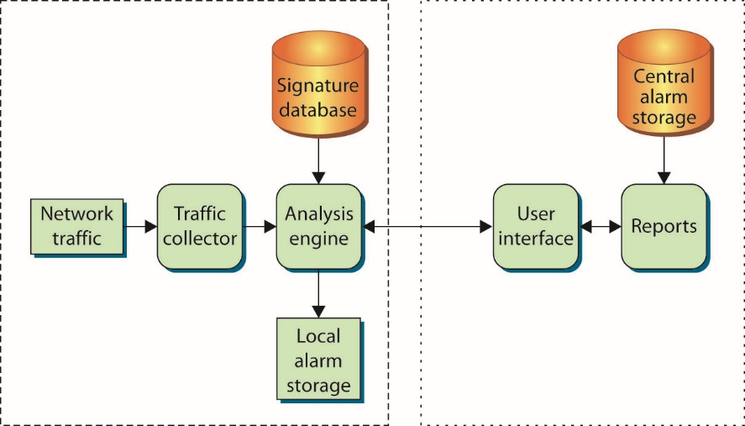
Figure 13.5 Distributed network IDS components
Notes:
This central system, shown in Figure 13.5, consolidated alarms and provided the user interface and reporting functions that allowed users in one location to manage, maintain, and monitor sensors deployed in a variety of remote locations.

Slide 136
Network-Based IDSs (continued)
By creating separate components designed to work together, the NIDS developers were able to build a more capable and flexible system.
With encrypted communications, network sensors could be placed around both local and remote perimeters and still be monitored and managed securely centrally.
Sensor placement quickly became an issue for most security personnel.
With firewalls present, location of the NIDS relative to the firewall had to be considered.
Notes:
By creating separate components designed to work together, the NIDS developers were able to build a more capable and flexible system. With encrypted communications, network sensors could be placed around both local and remote perimeters and still be monitored and managed securely from a central location. Placement of the sensors very quickly became an issue for most security personnel, as the sensors obviously had to have visibility of the network traffic in order to analyze it. Because most organizations with NIDSs also had firewalls, location of the NIDS relative to the firewall had to be considered as well.
Placed before the firewall, as shown in Figure 13.6, the NIDS will see all traffic coming in from the Internet, including attacks against the firewall itself. This includes traffic that the firewall stops and does not permit into the corporate network. With this type of deployment, the NIDS sensor will generate a large number of alarms (including alarms for traffic that the firewall would stop). This tends to overwhelm the human operators managing the system.

Slide 137
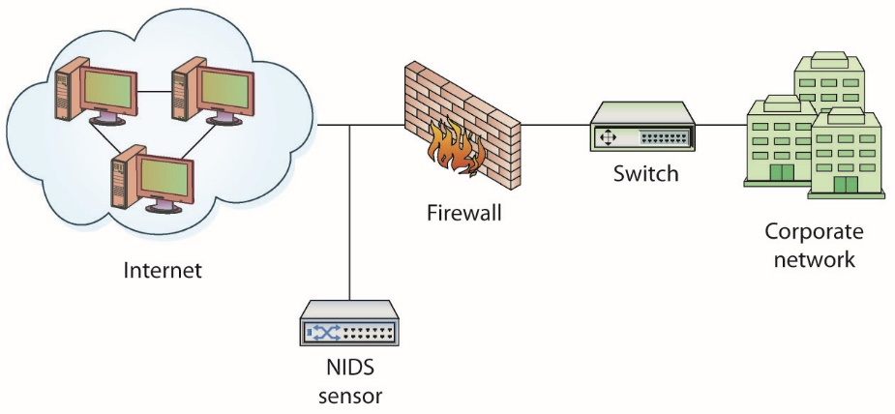
Figure 13.6 NIDS sensor placed in front of firewall
Notes:
Because most organizations with NIDSs also had firewalls, location of the NIDS relative to the firewall had to be considered as well.
Placed before the firewall, as shown in this figure, the NIDS will see all traffic coming in from the Internet, including attacks against the firewall itself. This includes traffic that the firewall stops and does not permit into the corporate network. With this type of deployment, the NIDS sensor will generate a large number of alarms (including alarms for traffic that the firewall would stop). This tends to overwhelm the human operators managing the system.

Slide 138
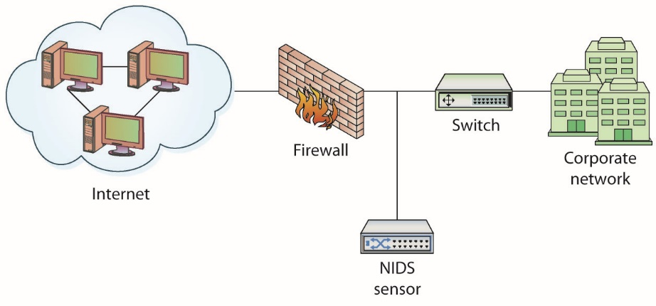
Figure 13.7 NIDS sensor placed behind firewall
Notes:
Placed after the firewall, as shown in Figure 13.7, the NIDS sensor sees and analyzes the traffic that is being passed through the firewall and into the corporate network. While this does not allow the NIDS to see attacks against the firewall, it generally results in far fewer alarms and is the most popular placement for NIDS sensors.

Slide 139
Network-Based IDSs (continued)
NIDSs examine the network traffic for suspicious or malicious activity.
Two examples illustrate the operation of NIDS:
Port scan – A port scan is a reconnaissance activity a potential attacker uses to find out information about the systems he wants to attack.
Ping of death – Certain operating systems could be crashed by sending a very large Internet Control Message Protocol (ICMP) echo request packet to that system.
Fairly simple traffic pattern for a NIDS to identify

Slide 140
Advantages of a NIDS
Providing IDS coverage requires fewer systems.
Deployment, maintenance, and upgrade costs are usually lower.
NIDS has visibility into all network traffic and can correlate attacks among multiple systems.
Notes:
A NIDS has certain advantages that make it a good choice for certain situations:
Providing IDS coverage requires fewer systems. With a few well-placed NIDS sensors, you can monitor all the network traffic going in and out of your organization. Fewer sensors usually equates to less overhead and maintenance, meaning you can protect the same number of systems at a lower cost.
Deployment, maintenance, and upgrade costs are usually lower. The fewer systems that have to be managed and maintained to provide IDS coverage, the lower the cost to operate the IDS. Upgrading and maintaining a few sensors is usually much cheaper than upgrading and maintaining hundreds of host-based processes.
A NIDS has visibility into all network traffic and can correlate attacks among multiple systems. Well-placed NIDS sensors can see the “big picture” when it comes to network-based attacks. The network sensors can tell you whether attacks are widespread and unorganized or focused and concentrated on specific systems.

Slide 141
Disadvantages of a NIDS
It is ineffective when traffic is encrypted.
It cannot see traffic that does not cross it.
It must be able to handle high volumes of traffic.
It does not know about activity on the hosts themselves.
Notes:
Disadvantages of a NIDS A NIDS has certain disadvantages:
It is ineffective when traffic is encrypted. When network traffic is encrypted from application to application or system to system, a NIDS sensor will not be able to examine that traffic. With the increasing popularity of encrypted traffic, this is becoming a bigger problem for effective IDS operations.
It can’t see traffic that does not cross it. The IDS sensor can examine only traffic crossing the network link it is monitoring. With most IDS sensors being placed on perimeter links, traffic traversing the internal network is never seen.
It must be able to handle high volumes of traffic. As network speeds continue to increase, the network sensors must be able to keep pace and examine the traffic as quickly as it can pass the network. When NIDSs were introduced, 10-Mbps networks were the norm. Now 100-Mbps and even 1-Gbps networks are commonplace. This increase in traffic speeds means IDS sensors must be faster and more powerful than ever before.
It doesn’t know about activity on the hosts themselves. NIDSs focus on network traffic. Activity that occurs on the hosts themselves will not be seen by a NIDS.

Slide 142
Active vs. Passive NIDSs
Passive NIDS
Simply watches traffic, analyzes it, and generates alarms
Does not interact with the traffic itself
Does not modify the defensive posture of the system to react to the traffic
Active NIDS
Contains all the same components and capabilities of the passive NIDS
Can react to the traffic it is analyzing
Notes:
Most NIDSs can be distinguished by how they examine the traffic and whether or not they interact with that traffic.
On a passive system, the NIDS simply watches the traffic, analyzes it, and generates alarms. It does not interact with the traffic itself in any way, and it does not modify the defensive posture of the system to react to the traffic. A passive NIDS is very similar to a simple motion sensor—it generates an alarm when it matches a pattern, much as the motion sensor generates an alarm when it sees movement.
An active NIDS contains all the same components and capabilities of the passive NIDS with one critical addition—the active NIDS can react to the traffic it is analyzing. These reactions can range from something simple, such as sending a TCP reset message to interrupt a potential attack and disconnect a session, to something complex, such as dynamically modifying firewall rules to reject all traffic from specific source IP addresses for the next 24 hours.

Slide 143
NIDS Tools
Snort has been the de facto standard IDS engine since its creation in 1998.
It has a large user base and set the standard for many IDS element, including rule sets and formats.
Suricata is an open source IDS, begun with grant money from the U.S. government and maintained by the Open Source Security Foundation (OSIF).
Has one advantage over Snort – supports multithreading.
Both systems are highly flexible and scalable, operating on both Windows and Linux platforms.
Notes:
Snort has been the de facto standard IDS engine since its creation in 1998. It has a large user base and set the standard for many IDS element, including rule sets and formats. Snort rules are the list of activities that Snort will alert on and provide the flexible power behind the IDS platform. Snort rule sets are updated by a large active community as well as Sourcefire Vulnerability Research Team, the company behind Snort. Snort VRT rule sets are available to subscribers and provide such elements as same-day protection for items such as Microsoft patch Tuesday vulnerabilities. These rules are moved to the open community after 30 days.
A newer entrant to the IDS marketplace is Suricata. Suricata is an open source IDS, begun with grant money from the U.S. government and maintained by the Open Source Security Foundation (OSIF). Suricata has one advantage over Snort: it supports multithreading, while Snort only supports single-threaded operation.

Slide 144
Host-Based IDSs
Host-based IDS (HIDS)
Examines log files, audit trails, and network traffic coming into or leaving a specific host
Operate in real time, looking for activity as it occurs, or in batch mode, looking for activity on a periodic basis
Typically self-contained
Take local system resources to operate
Focus on the log files or audit trails generated by the local operating system
Some cover specific applications (FTP or web services)
Notes:
Most HIDSs focus on the log files or audit trails generated by the local operating system. On UNIX systems, the examined logs usually include those created by syslog, such as messages, kernel logs, and error logs. On Windows systems, the examined logs are typically the three event logs: Application, System, and Security.
Some HIDSs can cover specific applications, such as FTP or web services, by examining the logs produced by those specific applications or examining the traffic from the services themselves.

Slide 145
Host-Based IDSs (continued)
Within the log files, the HIDS is looking for certain activities that typify hostile actions or misuse:
Logins at odd hours
Login authentication failures
Additions of new user accounts
Modification or access of critical system files
Modification or removal of binary files (executables)
Starting or stopping processes
Privilege escalation
Use of certain programs
Notes:
Within the log files, the HIDS is looking for certain activities that typify hostile actions or misuse, such as the following:
Logins at odd hours
Login authentication failures
Additions of new user accounts
Modification or access of critical system files
Modification or removal of binary files (executables)
Starting or stopping processes
Privilege escalation
Use of certain programs

Slide 146
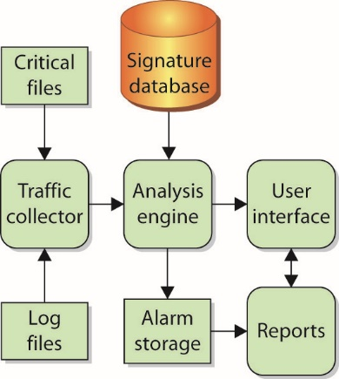
Figure 13.8 Host-based IDS components
Notes:
In general, most HIDSs operate in a very similar fashion. This figure shows the logical layout of a HIDS. By considering the function and activity of each component, you can gain some insight into how HIDSs operate.

Slide 147
Host-Based IDSs (continued)
HIDS components
Traffic collector – pulls in the information the other components, such as the analysis engine
Analysis engine mechanism – looks at the information provided by the traffic collector and tries to match it against known patterns of activity stored in the signature database
Signature database – a collection of predefined activity patterns that have already been identified and categorized
User interface – part that humans interact with
Notes:
As on any IDS, the traffic collector on a HIDS pulls in the information the other components, such as the analysis engine, need to examine. For most HIDSs, the traffic collector pulls data from information the local system has already generated, such as error messages, log files, and system files. The traffic collector is responsible for reading those files, selecting which items are of interest, and forwarding them to the analysis engine. On some HIDSs, the traffic collector also examines specific attributes of critical files, such as file size, date modified, or checksum.
The analysis engine is perhaps the most important component of the HIDS, as it must decide what activity is “okay” and what activity is “bad.” The analysis engine is a sophisticated decision and pattern-matching mechanism—it looks at the information provided by the traffic collector and tries to match it against known patterns of activity stored in the signature database. If the activity matches a known pattern, the analysis engine can react, usually by issuing an alert or alarm. An analysis engine may also be capable of remembering how the activity it is looking at right now compares to traffic it has already seen or may see in the near future, so that it can match more complicated, multistep malicious activity patterns. An analysis engine must also be capable of examining traffic patterns as quickly as possible, as the longer it takes to match a malicious pattern, the less time the HIDS or human operator has to react to malicious traffic. Most HIDS vendors build a decision tree into their analysis engines to expedite pattern matching.
The signature database is a collection of predefined activity patterns that have already been identified and categorized—patterns that typically indicate suspicious or malicious activity. When the analysis engine has an activity or traffic pattern to examine, it compares that pattern to the appropriate signatures in the database. The signature database can contain anywhere from a few to a few thousand signatures, depending on the vendor, type of HIDS, space available on the system to store signatures, and other factors.
The user interface is the visible component of the HIDS—the part that humans interact with. The user interface varies widely depending on the product and vendor and could be anything from a detailed GUI to a simple command line. Regardless of the type and complexity, the interface is provided to allow the user to interact with the system: changing parameters, receiving alarms, tuning signatures and response patterns, and so on.

Slide 148
Advantages of HIDSs
Very operating system–specific with more detailed signatures
Reduce false-positive rates
Examine data after it has been decrypted
Very application specific
Determine whether or not an alarm may impact that specific system
Notes:
HIDSs have certain advantages that make them a good choice for certain situations:
They can be very operating system–specific and have more detailed signatures. A HIDS can be very specifically designed to run on a certain operating system or to protect certain applications. This narrow focus lets developers concentrate on the specific things that affect the specific environment they are trying to protect. With this type of focus, the developers can avoid generic alarms and develop much more specific, detailed signatures to identify malicious traffic more accurately.
They can reduce false-positive rates. When running on a specific system, the HIDS process is much more likely to be able to determine whether or not the activity being examined is malicious. By more accurately identifying which activity is “bad,” the HIDS will generate fewer false positives (alarms generated when the traffic matches a pattern but is not actually malicious).
They can examine data after it has been decrypted. With security concerns constantly on the rise, many developers are starting to encrypt their network communications. When designed and implemented in the right manner, a HIDS will be able to examine traffic that is unreadable to a network-based IDS. This particular ability is becoming more important each day as more and more web sites start to encrypt all of their traffic.
They can be very application specific. On a host level, the IDS can be designed, modified, or tuned to work very well on specific applications without having to analyze or even hold signatures for other applications that are not running on that particular system. Signatures can be built for specific versions of web server software, FTP servers, mail servers, or any other application housed on that host.
They can determine whether or not an alarm may impact that specific system. The ability to determine whether or not a particular activity or pattern will really affect the system being protected assists greatly in reducing the number of generated alarms. Because the HIDS resides on the system, it can verify things such as patch levels, presence of certain files, and system state when it analyzes traffic. By knowing what state the system is in, the HIDS can more accurately determine whether an activity is potentially harmful to the system.

Slide 149
Disadvantages of HIDSs
Must have a process on every system you want to watch
High cost of ownership and maintenance
Uses local system resources
Very focused view and cannot relate to activity around it
If logging only locally, could be compromised or disabled
Notes:
HIDSs also have certain disadvantages that must be weighed in making the decision of whether to deploy this type of technology:
The HIDS must have a process on every system you want to watch. You must have a HIDS process or application installed on every host you want to watch. To watch 100 systems, then, you would need to deploy 100 HIDSs, or remote agents.
The HIDS can have a high cost of ownership and maintenance. Depending on the specific vendor and application, a HIDS can be fairly costly in terms of time and manpower to maintain. Unless some type of central console is used that allows you to maintain remote processes, administrators must maintain each HIDS process individually. Even with a central console, with a HIDS, there will be a high number of processes to maintain, software to update, and parameters to tune.
The HIDS uses local system resources. To function, the HIDS must use CPU cycles and memory from the system it is trying to protect. Whatever resources the HIDS uses are no longer available for the system to perform its other functions. This becomes extremely important on applications such as high-volume web servers, where fewer resources usually means fewer visitors served and the need for more systems to handle expected traffic.
The HIDS has a very focused view and cannot relate to activity around it. The HIDS has a limited view of the world, as it can see activity only on the host it is protecting. It has little to no visibility into traffic around it on the network or events taking place on other hosts. Consequently, a HIDS can tell you only if the system it is running on is under attack.
The HIDS, if logging only locally, could be compromised or disabled. When a HIDS generates alarms, it typically stores the alarm information in a file or database of some sort. If the HIDS stores its generated alarm traffic on the local system, an attacker that is successful in breaking into the system may be able to modify or delete those alarms. This makes it difficult for security personnel to discover the intruder and conduct any type of post-incident investigation. A capable intruder may even be able to turn off the HIDS process completely.

Slide 150
Active vs. Passive HIDSs
Passive HIDS
Simply watches the activity, analyzes it, and generates alarms
Does not interact with the activity itself in any way
Does not modify the defensive posture of the system to react to the traffic
Active HIDS
Contain all components and capabilities of the passive IDs
Can react to the activity it is analyzing
Notes:
Most IDSs can be distinguished by how they examine the activity around them and whether or not they interact with that activity. This is certainly true for HIDSs. On a passive system, the HIDS is exactly that—it simply watches the activity, analyzes it, and generates alarms. It does not interact with the activity itself in any way, and it does not modify the defensive posture of the system to react to the traffic. A passive HIDS is similar to a simple motion sensor—it generates an alarm when it matches a pattern, much as the motion sensor generates an alarm when it sees movement.
An active IDS will contain all the same components and capabilities of the passive IDS with one critical exception—the active IDS can react to the activity it is analyzing. These reactions can range from something simple, such as running a script to turn a process on or off, to something as complex as modifying file permissions, terminating the offending processes, logging off specific users, and reconfiguring local capabilities to prevent specific users from logging in for the next 12 hours.

Slide 151
Resurgence and Advancement of HIDSs
The past few years have seen a strong resurgence in the use of HIDSs.
The latest generation of HIDSs has introduced new capabilities designed to stop attacks by preventing them from ever executing or accessing protected files in the first place.
Does not rely on a specific signature set that only matches known attacks

Slide 152
Resurgence and Advancement of HIDSs (continued)
Modern HIDS is often referred to as host-based intrusion prevention systems (HIPS).
HIPS use the following components to prevent attacks:
Integrated system firewall
Behavioral- and signature-based IDS
Application control
Enterprise management
Malware detection and prevention
Notes:
The latest generation of HIDSs has introduced new capabilities designed to stop attacks by preventing them from ever executing or accessing protected files in the first place, rather than relying on a specific signature set that only matches known attacks.
The more advanced host-based offerings, which most vendors refer to as host-based intrusion prevention systems (HIPSs), combine the following elements into a single package:
Integrated system firewall – The firewall component checks all network traffic passing into and out of the host. Users can set rules for what types of traffic they want to allow into or out of their system.
Behavioral- and signature-based IDS – This hybrid approach uses signatures to match well-known attacks and generic patterns for catching “zero-day” or unknown attacks for which no signatures exist.
Application control – This allows administrators to control how applications are used on the system and whether or not new applications can be installed. Controlling the addition, deletion, or modification of existing software can be a good way to control a system’s baseline and prevent malware from being installed.
Enterprise management – Some host-based products are installed with an “agent” that allows them to be managed by and report back to a central server. This type of integrated remote management capability is essential in any large-scale deployment of host-based IDS/IPS.
Malware detection and prevention – Some HIDSs/HIPSs include scanning and prevention capabilities that address spyware, malware, rootkits, and other malicious software.

Slide 153
Module 6 Authentication and Remote Access and Intrusion Detection Systems and Network Security – Part 4

Slide 154
Intrusion Prevention Systems
An intrusion prevention system (IPS) monitors network traffic for malicious or unwanted behavior and can block, reject, or redirect that traffic in real time.
IPSs have an internal signature database to compare network traffic against known “bad” traffic patterns.
IPSs can perform content-based inspections.
Some IPSs can perform protocol inspection.
IPS can detect and defeat popular evasion techniques such as encoding URLs.

Slide 155
Intrusion Prevention Systems (continued)
Unlike a traditional IDS, an IPS must sit inline (in the flow of traffic) to be able to interact effectively with the network traffic.
Like a traditional IDS, the IPS has a potential weakness when dealing with encrypted traffic.
IPSs (and IDSs) often marketed by the amount of traffic they can process without dropping packets or interrupting the flow of network traffic.
In reality, a network never reach its hypothetical maximum transmission rate, or wire speed.

Slide 156
Honeypots and Honeynets
A honeypot, sometimes called a digital sandbox, is an artificial environment where attackers can be contained and observed without putting real systems at risk.
Appears to an attacker to be a real network
Activity recorded for later analysis
Afford information and additional security but require significant time, cost and effort to maintain
A honeynet is a collection of two or more honeypots.
Notes:
Exam Tip: A honeypot is a system designed to attract potential attackers by pretending to be one or more systems with open network services.
As is often the case, one of the best tools for information security personnel has always been knowledge. To secure and defend a network and the information systems on that network properly, security personnel need to know what they are up against. What types of attacks are being used? What tools and techniques are popular at the moment? How effective is a certain technique? What sort of impact will this tool have on my network? Often this sort of information is passed through white papers, conferences, mailing lists, or even word of mouth. In some cases, the tool developers themselves provide much of the information in the interest of promoting better security for everyone.
Information is also gathered through examination and forensic analysis, often after a major incident has already occurred and information systems are already damaged. One of the most effective techniques for collecting this type of information is to observe activity firsthand—watching an attacker as he probes, navigates, and exploits his way through a network. To accomplish this without exposing critical information systems, security researchers often use something called a honeypot.
Larger, very diverse network environments can deploy multiple honeypots (thus forming a honeynet) when a single honeypot device does not provide enough coverage. Honeynets are often integrated into an organization-wide IDS/IPS because the honeynet can provide relevant information about potential attackers.

Slide 157
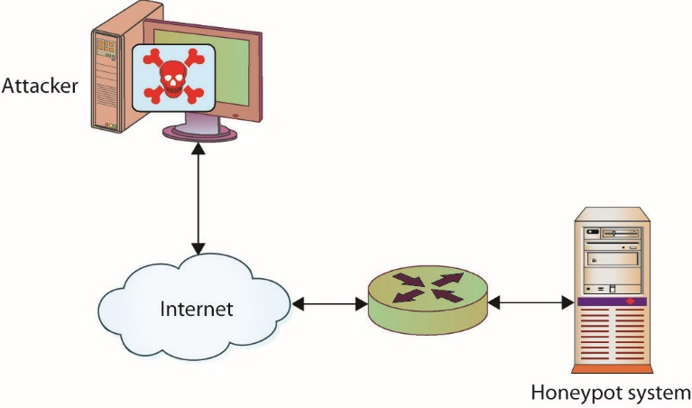
Figure 13.9 Logical depiction of a honeypot
Notes:
A good honeypot appears to an attacker to be a real network consisting of application servers, user systems, network traffic, and so on, but in most cases it’s actually made up of one or a few systems running specialized software to simulate the user and network traffic common to most targeted networks. This figure illustrates a simple honeypot layout in which a single system is placed on the network to deliberately attract attention from potential attackers.
This figure shows the security researcher’s view of the honeypot.

Slide 158
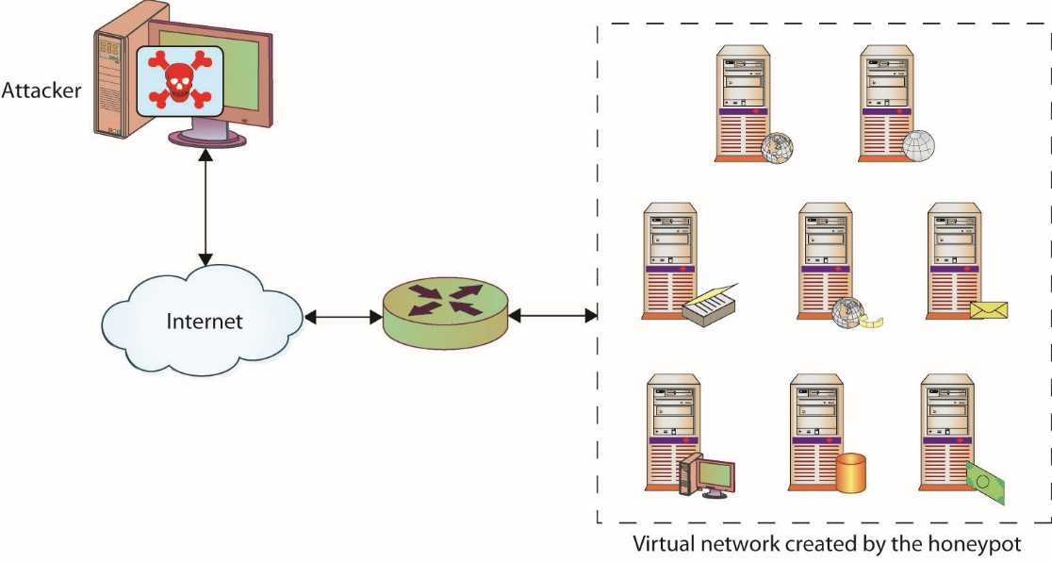
Figure 13.10 Virtual network created by the honeypot
Notes:
This figure shows the attacker’s view of a honeypot.

Slide 159
Tools
Tools are a vital part of any security professional’s skill set.
Tools can be used for internal assessment activities, tracking down infected systems, spotting inappropriate behavior, and so on.
Knowing the right tool for the job can be critical to performing effectively.

Slide 160
Protocol Analyzer
A protocol analyzer (also known as a packet sniffer, network analyzer, or network sniffer) is a piece of software or an integrated software/hardware system that can capture and decode network traffic.
They have been popular with system administrators and security professionals for decades because they are such versatile and useful tools for a network environment.

Slide 161
Protocol Analyzer (continued)
Protocol analyzers can be used for several activities:
Detecting intrusions or undesirable traffic (an IDS/IPS must have some type of capture and decode ability to be able to look for suspicious/malicious traffic)
Capturing traffic during incident response or incident handling
Looking for evidence of botnets, Trojans, and infected systems
Looking for unusual traffic or traffic exceeding certain thresholds
Testing encryption between systems or applications

Slide 162
Protocol Analyzer (continued)
From a network administration perspective, protocol analyzers can be used for activities such as these:
Analyzing network problems
Detecting misconfigured applications or misbehaving applications
Gathering and reporting network usage and traffic statistics
Debugging client/server communications

Slide 163
Protocol Analyzer (continued)
A protocol analyzer must be able to see network traffic in order to capture and decode it.
A software-based protocol analyzer must be able to place the NIC it is going to use to monitor network traffic in promiscuous mode (sometimes called promisc mode).
With switches now the standard for networking equipment, placing a protocol analyzer becomes more difficult as switches do not broadcast every packet across every port.
Notes:
Promiscuous mode tells the NIC to process every network packet it sees regardless of the intended destination. Normally, a NIC processes only broadcast packets (which go to everyone on that subnet) and packets with the NIC’s Media Access Control (MAC) address as the destination address inside the packet. As a sniffer, the analyzer must process every packet crossing the wire, so the ability to place a NIC into promiscuous mode is critical.
With older networking technologies, such as hubs, it was easier to operate a protocol analyzer, as the hub broadcasted every packet across every interface regardless of the destination. With switches now the standard for networking equipment, placing a protocol analyzer becomes more difficult as switches do not broadcast every packet across every port. While this may make it harder for administrators to sniff the traffic, it also makes it harder for eavesdroppers and potential attackers.

Slide 164
Protocol Analyzer (continued)
To accommodate protocol analyzers, IDS devices, and IPS devices, most switch manufacturers support port mirroring or a Switched Port Analyzer (SPAN) port.
Another option for traffic capture is to use a network tap.
A hardware device that can be placed inline on a network connection and that will copy traffic passing through the tap to a second set of interfaces on the tap
Notes:
Depending on the manufacturer and the hardware, a mirrored port will see all the traffic passing through the switch or through a specific VLAN(s), or all the traffic passing through other specific switch ports. The network traffic is essentially copied (or mirrored) to a specific port, which can then support a protocol analyzer.
Another option for traffic capture is to use a network tap, a hardware device that can be placed inline on a network connection and that will copy traffic passing through the tap to a second set of interfaces on the tap. Network taps are often used to sniff traffic passing between devices at the network perimeter, such as the traffic passing between a router and a firewall.

Slide 165
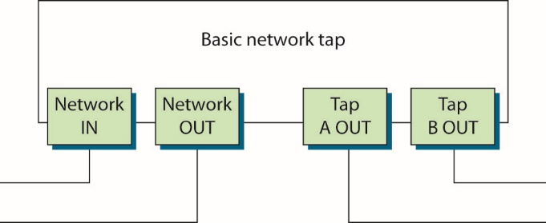
Figure 13.11 A basic network tap
Notes:
Many common network taps work by bridging a network connection and passing incoming traffic out one tap port (A) and outgoing traffic out another tap port (B), as shown in this figure.

Slide 166
Protocol Analyzer (continued)
Wireshark is a popular, open source protocol.
Available for both UNIX and Windows operating systems
GUI-based protocol analyzer
Can capture and decode network traffic on any available network interface in the system on which the software is running (including wireless interfaces),
Includes the ability to “follow the TCP stream” and then see all the other packets involved in that TCP conversation

Slide 167
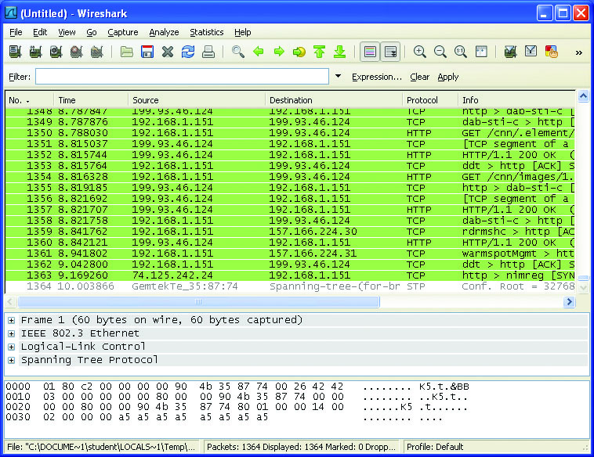
Figure 13.12 Wireshark—a popular, open source protocol analyzer
Notes:
Wireshark is a GUI-based protocol analyzer that allows users to capture and decode network traffic on any available network interface in the system on which the software is running (including wireless interfaces), as demonstrated in this figure.

Slide 168
Switched Port Analyzer
The term Switched Port Analyzer (SPAN) is usually associated with Cisco switches—other vendors refer to the same capability as port mirroring or port monitoring.
A SPAN has the ability to copy network traffic passing through one or more ports on a switch or one or more VLANs on a switch and forward that copied traffic to a port designated for traffic capture and analysis
When configuring port mirroring, you need to be aware of the capabilities of the switch with which you are working.
Notes:
A SPAN port or mirror port creates the collection point for traffic that will be fed into a protocol analyzer or IDS/IPS. SPAN or mirror ports can usually be configured to monitor traffic passing into interfaces, passing out of interfaces, or passing in both directions. When configuring port mirroring, you need to be aware of the capabilities of the switch you are working with.

Slide 169
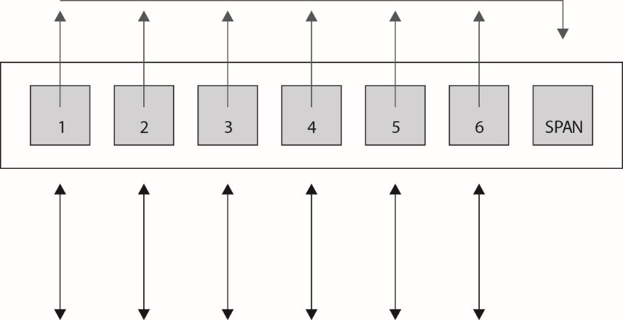
Figure 13.13 A SPAN port collects traffic from other ports on a switch.
Notes:
A SPAN has the ability to copy network traffic passing through one or more ports on a switch or one or more VLANs on a switch and forward that copied traffic to a port designated for traffic capture and analysis as shown in this figure.

Slide 170
Port Scanner
A port scanner is a tool designed to probe a system or systems for open ports.
Its job is to probe for open (or listening) ports and report back to the user which ports are closed, which are filtered, and which are open.
Port scanners are available for virtually every operating system and almost every popular mobile computing platform.

Slide 171
Port Scanner (continued)
Port scanners can be used to:
Search for “live” hosts on a network
Search for any open ports on the network
Search for specific ports
Identify services on ports
Look for TCP/UDP services
Security professionals use them in much the same way an attacker would: to probe the systems in your network for open services.
Notes:
Port scanners can be used to do the following:
Search for “live” hosts on a network. Most port scanners enable you to perform a quick scan using ICMP, TCP, or UDP packets to search for active hosts on a given network or network segment. ICMP is still very popular for this task, but with the default blocking of ICMP v4 in many modern operating systems, such as Windows 7 and beyond, users are increasingly turning to TCP or UDP scans for these tasks.
Search for any open ports on the network. Port scanners are most often used to identify any open ports on a host, group of hosts, or network. By scanning a large number of ports over a large number of hosts, a port scanner can provide you (or an attacker) with a very good picture of what services are running on which hosts on your network. Scans can be done for the “default” set of popular ports, a large range of ports, or every possible port (from 1 to 65535).
Search for specific ports. Only looking for web servers? Mail servers? Port scanners can also be configured to just look for specific services.
Identify services on ports. Some port scanners can help identify the services running on open ports based on information returned by the service or the port/service assigned (if standards have been followed). For example, a service running on port 80 is likely to be a web server.
Look for TCP/UDP services. Most port scanners can perform scans for both TCP and UDP services, although some tools do not allow you to scan for both protocols at the same time.
As a security professional, you’ll use port scanners in much the same way an attacker would: to probe the systems in your network for open services. When you find open services, you’ll need to determine if those services should be running at all, if they should be running on the system(s) you found them on, and if you can do anything to limit what connections are allowed to those services. For example, you may want to scan your network for any system accepting connections on TCP port 1433 (Microsoft SQL Server). If you find a system accepting connections on TCP port 1433 in your Sales group, chances are someone has installed something they shouldn’t have (or someone installed something for them).

Slide 172
Port Scanner (continued)
By examining the responses from each port, you can typically deduce a bit more information about the system(s) you are scanning.
Open – Open ports accept connections.
Closed – Typically see this response when the scanned target returns an RST packet.
Filtered – Typically see this response when an ICMP unreachable error is returned.
Additional types – Some port scanners will attempt to further classify responses, such as dropped, blocked, denied, timeout, and so on.

Slide 173
Port Scanner (continued)
Defending against port scans is tough.
You can block IP addresses that scan you.
Most organizations do not because you run the risk of an attacker spoofing source addresses as decoys for other scanning activity.
The best defense is to carefully control what traffic you let in and out of your network, using firewalls, network filters, and host filters.
Carefully monitor any traffic allowed into the network

Slide 174
Passive vs. Active Tools
Active tools interact with a target system in a fashion where their use can be detected.
Scanning a network with Nmap (Network Mapper) is an active act that can be detected.
Passive tools are those that do not interact with the system in a manner that would permit detection, as in sending packets or altering traffic.
Examples include Tripwire and OS mapping by analyzing TCP/IP traces with a tool such as Wireshark.
They can use existing traffic to provide data for analysis.
Notes:
Active tools interact with a target system in a fashion where their use can be detected. Scanning a network with Nmap (Network Mapper) is an active act that can be detected. In the case of Nmap, the tool may not be specifically detectable, but its use, the sending of packets, can be detected. When you need to map out your network or look for open services on one or more hosts, a port scanner is probably the most efficient tool for the job.
Passive tools are those that do not interact with the system in a manner that would permit detection, as in sending packets or altering traffic. An example of a passive tool is Tripwire, which can detect changes to a file based on hash values. Another passive example is the OS mapping by analyzing TCP/IP traces with a tool such as Wireshark. Passive sensors can use existing traffic to provide data for analysis.

Slide 175
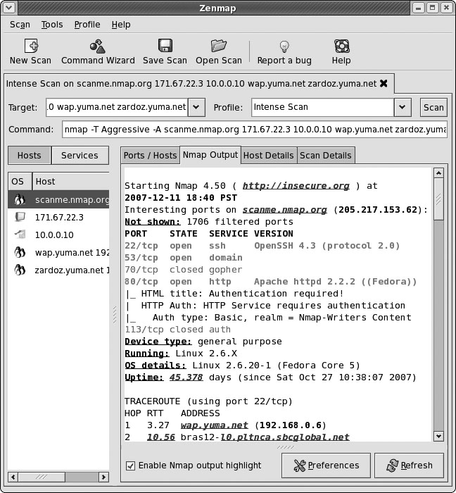
Figure 13.14 Zenmap—a port scanner based on Nmap
Notes:
Figure 13.14 shows a screen shot of Zenmap, a cross-platform version of the very popular Nmap port scanner available from http://insecure.org.

Slide 176
Banner Grabbing
Banner grabbing is a technique used to gather information from a service that publicizes information via a banner.
Banners can be used for many things.
Identify services by type, version, and so forth
Enable administrators to post information, including warnings, to users when they log in
Attackers determine services running
Notes:
Attackers can use banners to determine what services are running, and typically do for common banner issuing services such as HTTP, FTP, SMTP, and Telnet.

Slide 177
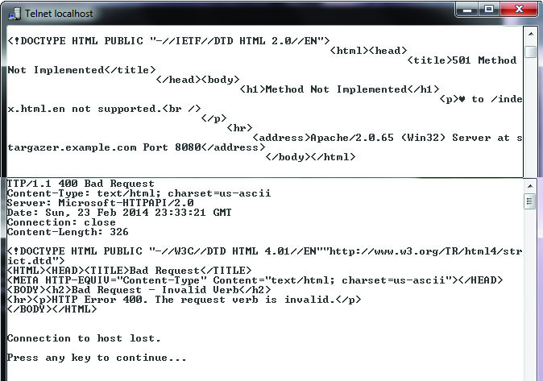
Figure 13.15 Banner grabbing using Telnet
Notes:
This figure shows a couple of banner grabs being performed from a Telnet client against a web server. In this example, Telnet sends information to two different web servers and displays the responses (the banners). The top response is from an Apache instance (Apache/2.0.65) and the bottom is from Microsoft IIS (Microsoft-HTTPAPI/2.0).

